Slide 1
Requirement Baselining in RMsis
Simplify Requirement Management for JIRA

Slide 2
Introduction
Meaning of Baseline
  Once requirement(s) are defined, reviewed and approved by each stake holder, they are baselined
  Baselined requirement(s) can not be changed
  If there are further changes in baselined requirement(s), then new baseline should be created
Baseline in RMsis
  RMsis supports following mechanisms for baseline
    Immediate: Requirement manager can select requirements and create a baseline
    Mark and Baseline: Requirement manager can first “Mark” the target requirements and then baseline can be created after consensus
    Link to Baseline : Requirement manager can select requirement(s) and link it to an already existing baseline (which is not committed)

Slide 3
Immediate Baselining

Slide 4
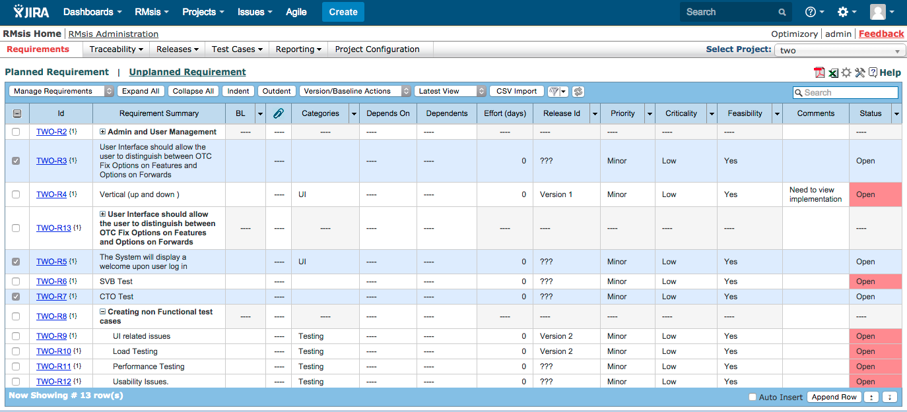
Select Requirements for Baseline
Various filters can be used to select requirement set

Slide 5
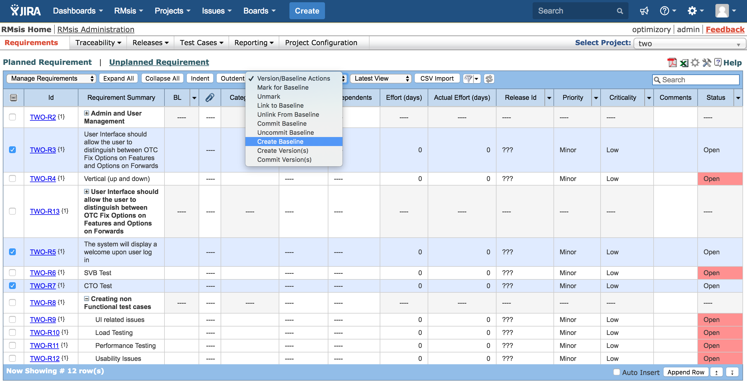
Create Baseline

Slide 6
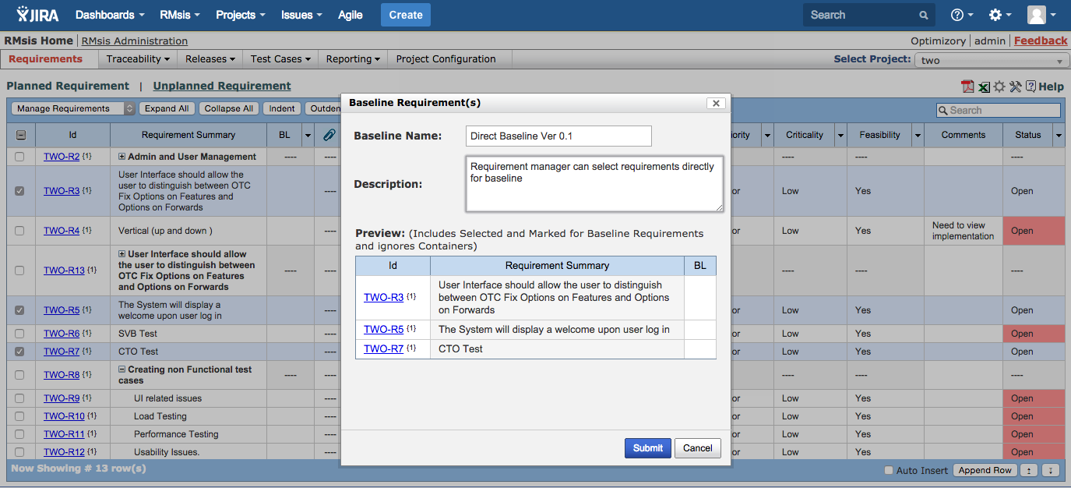
Provide Name and Description to Baseline
Selected requirements can be previewed before finalization.

Slide 7
Mark and Baseline

Slide 8
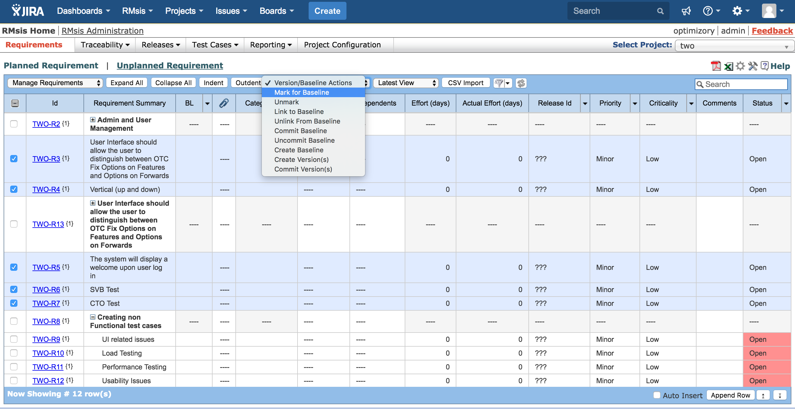
Select Requirement(s) to Mark for Baseline
Requirements can be discussed with various stake holders and once finalized can be marked for baseline

Slide 9
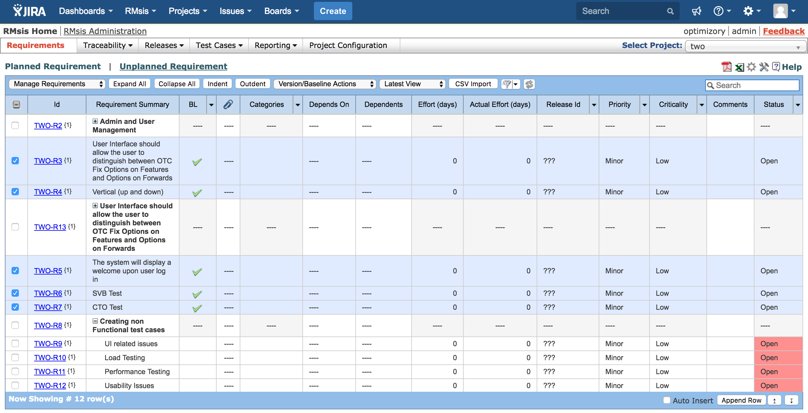
Initial set of requirements are marked

Slide 10
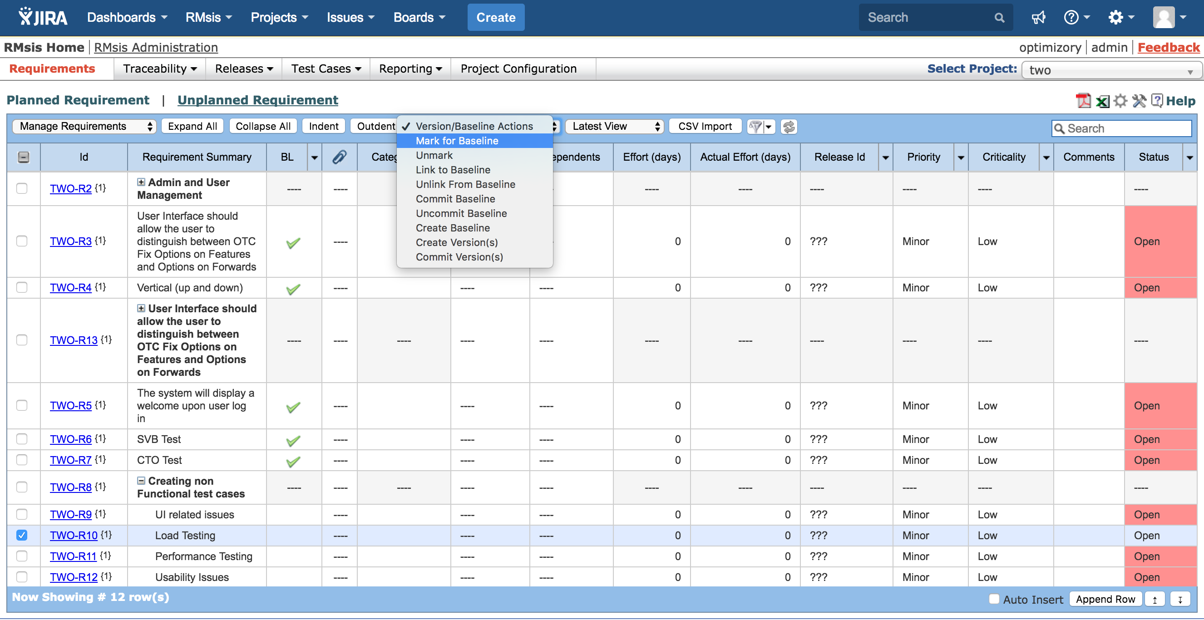
Mark more Requirement(s) for Baseline
Requirement manager can discuss more requirements iteratively and mark them for baseline

Slide 11
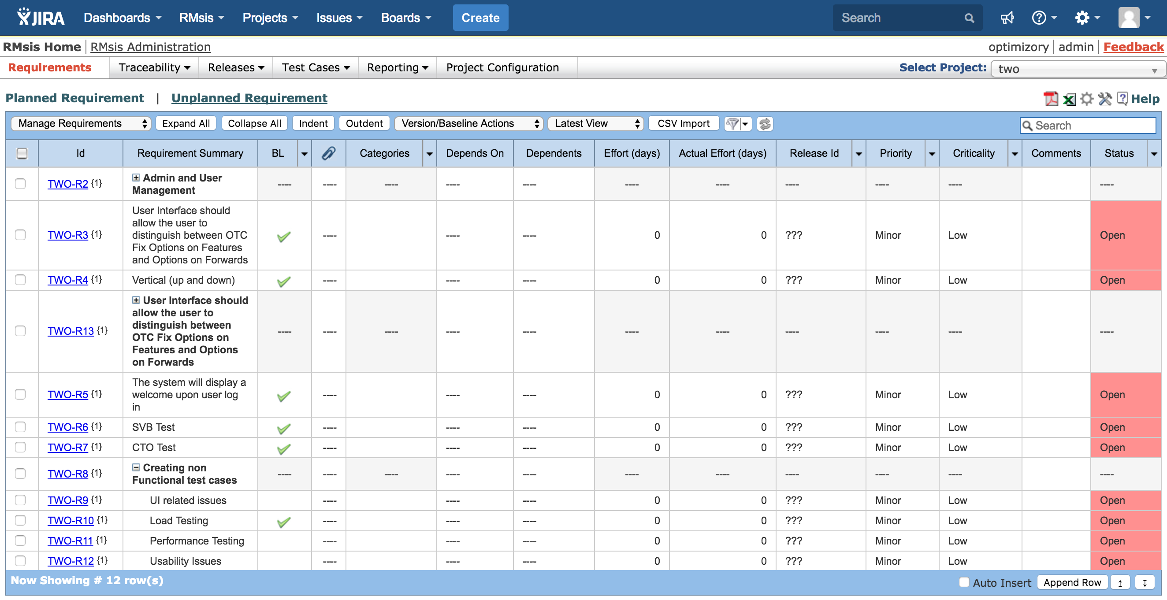
Create Baseline
Once all requirements are discussed, they can be baselined.

Slide 12
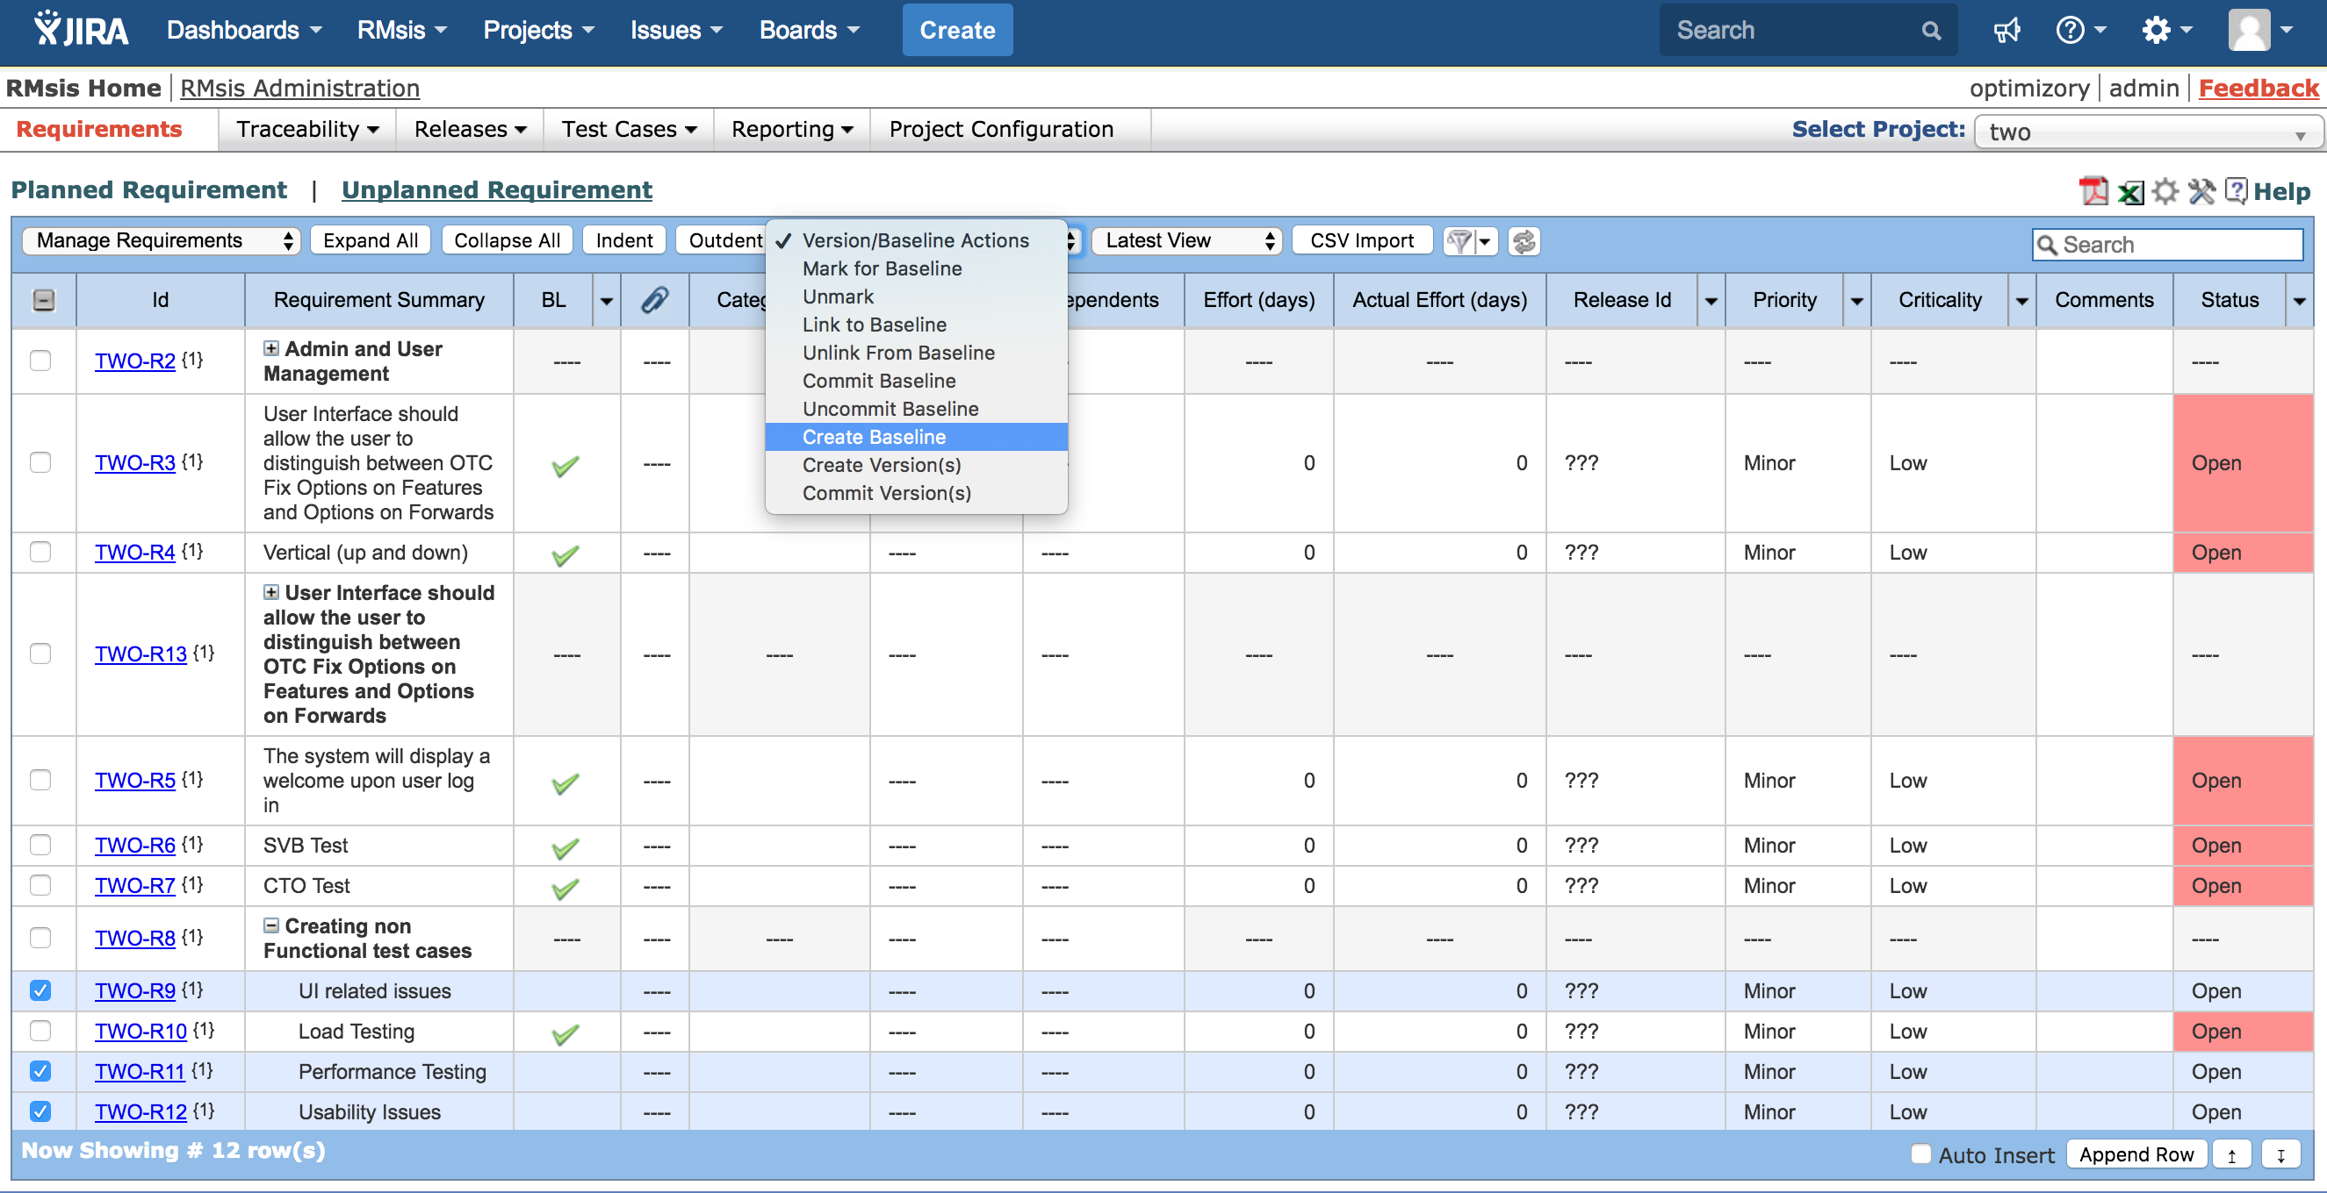
Create Baseline
In addition to selected requirements, ones which are marked for baseline will also be selected

Slide 13
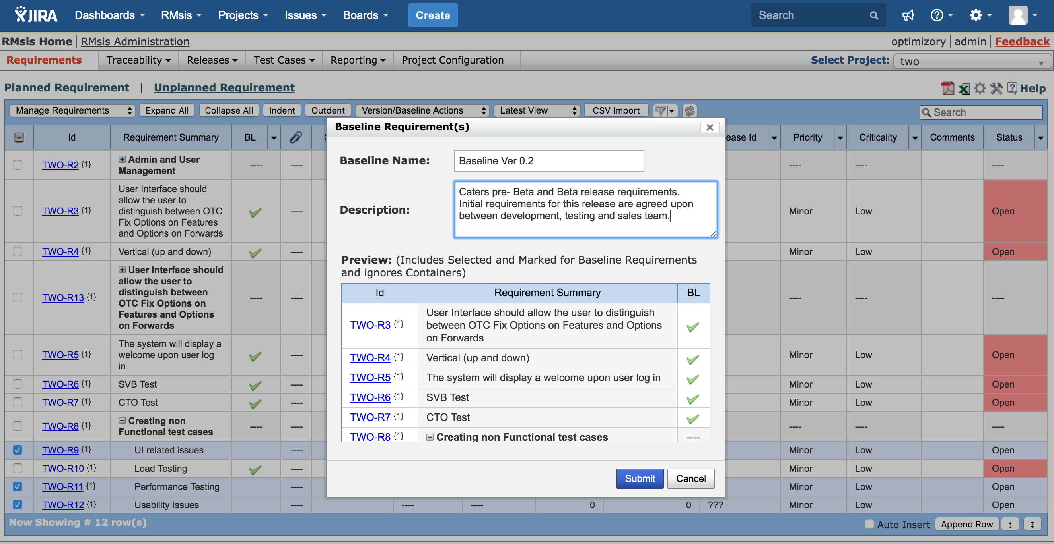
Provide Appropriate Name to Baseline

Slide 14
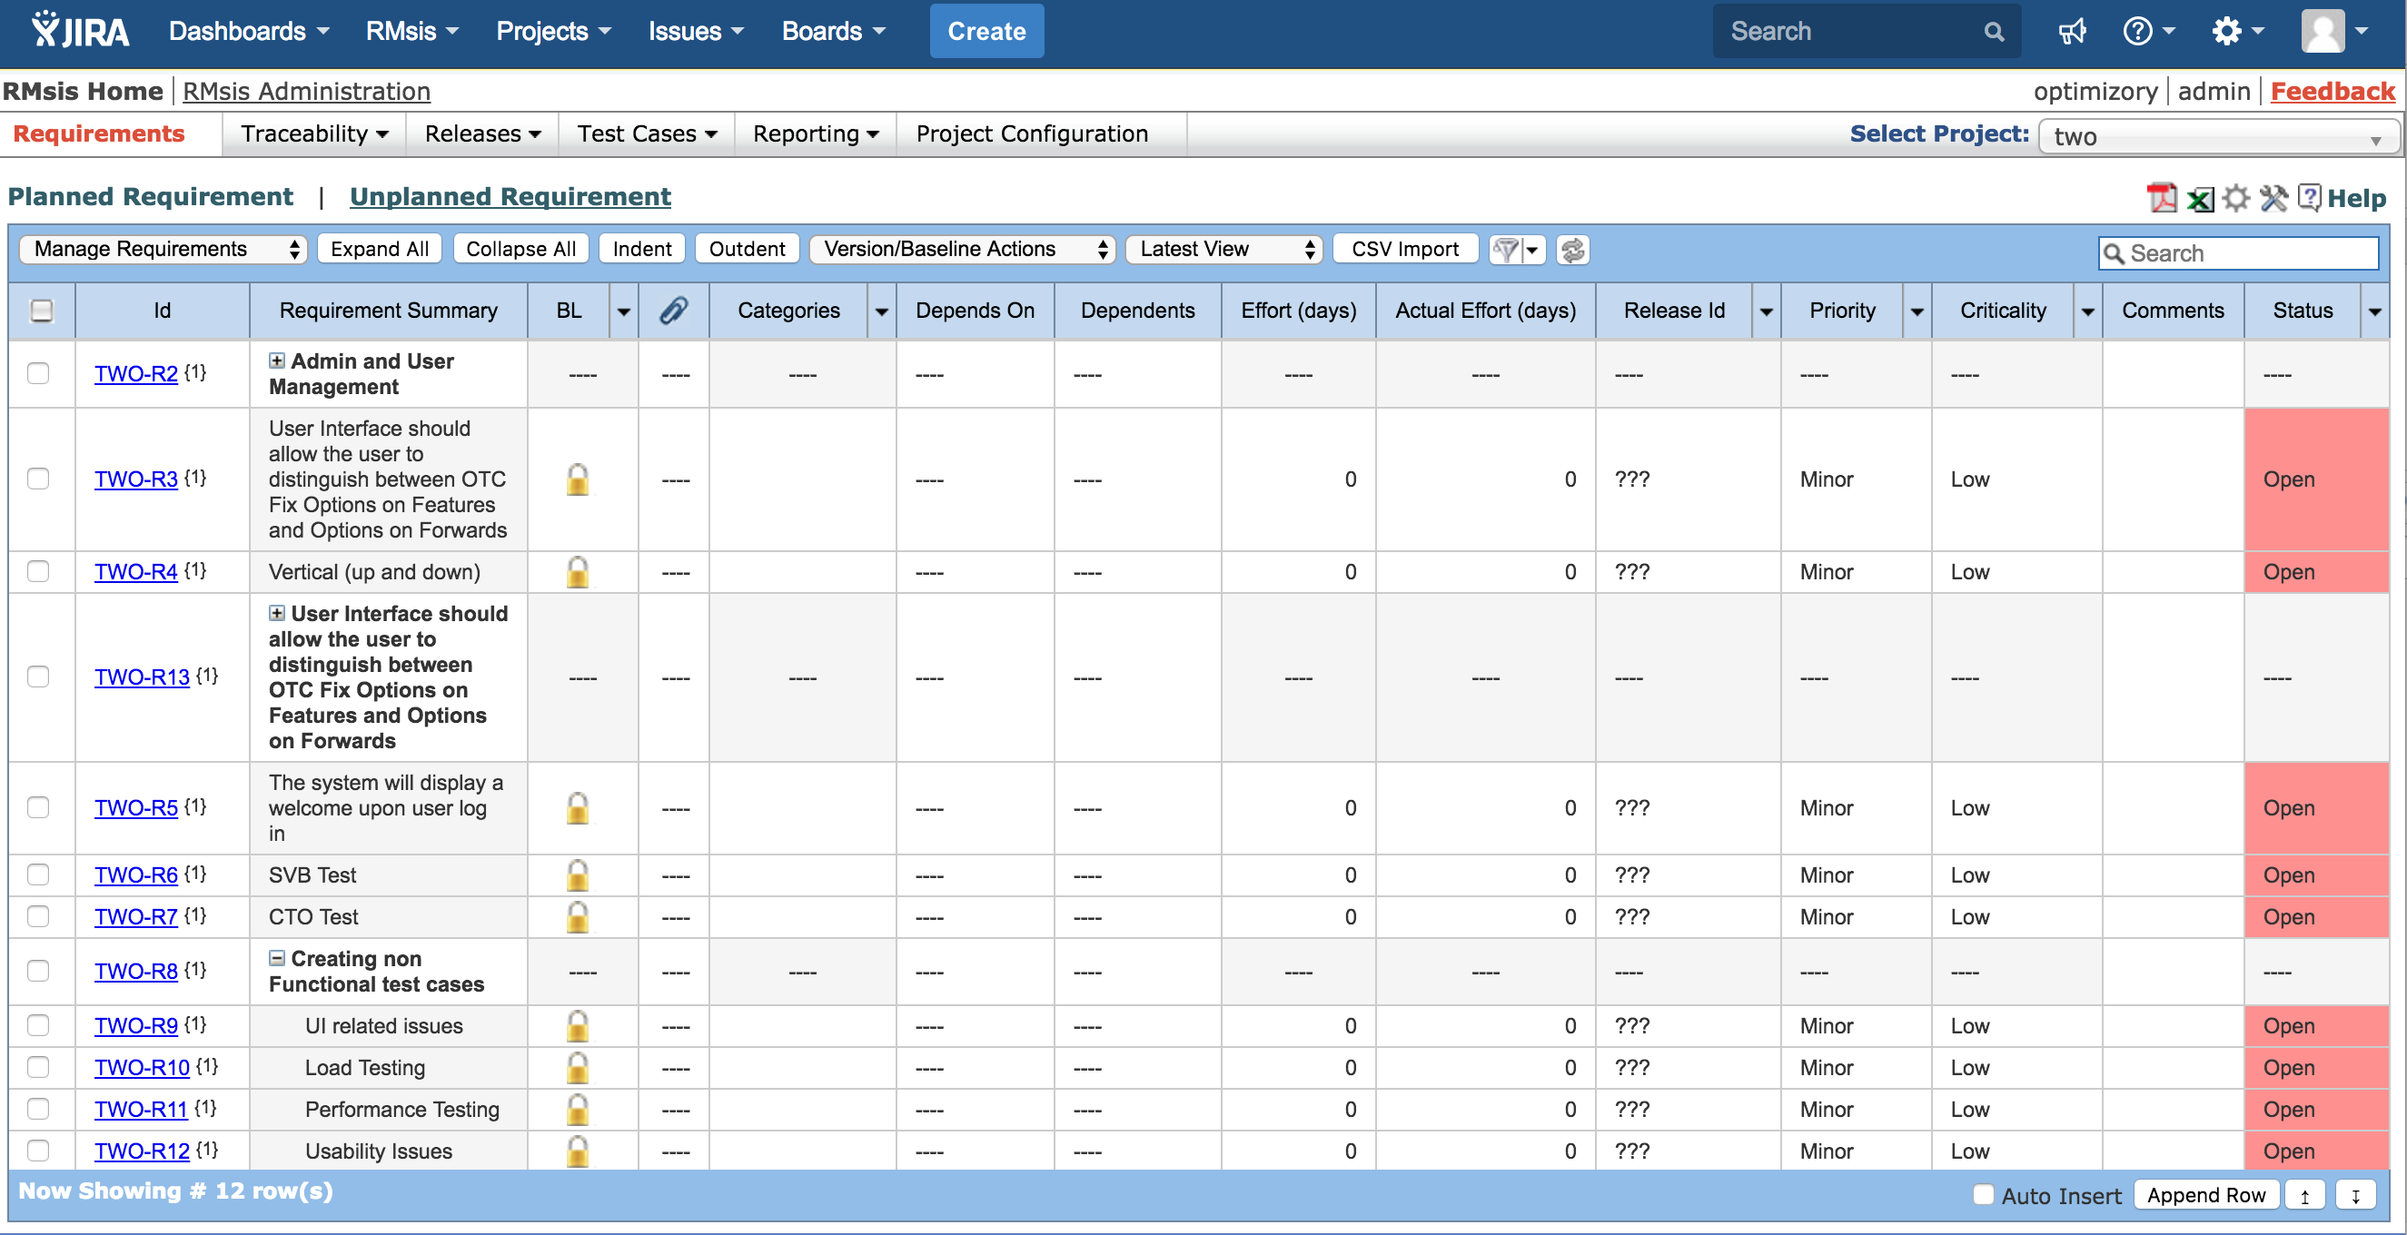
Base line Created
Finally a baseline is created, which has been discussed, reviewed and agreed upon by all stakeholders

Slide 15
Link To Baseline

Slide 16
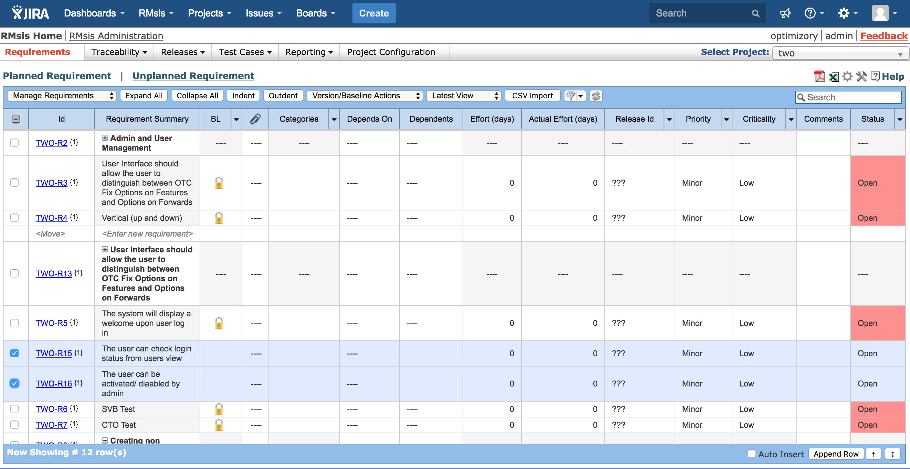
Select Requirements to be baselined
Select requirements that needs to be added to an existing baseline

Slide 17
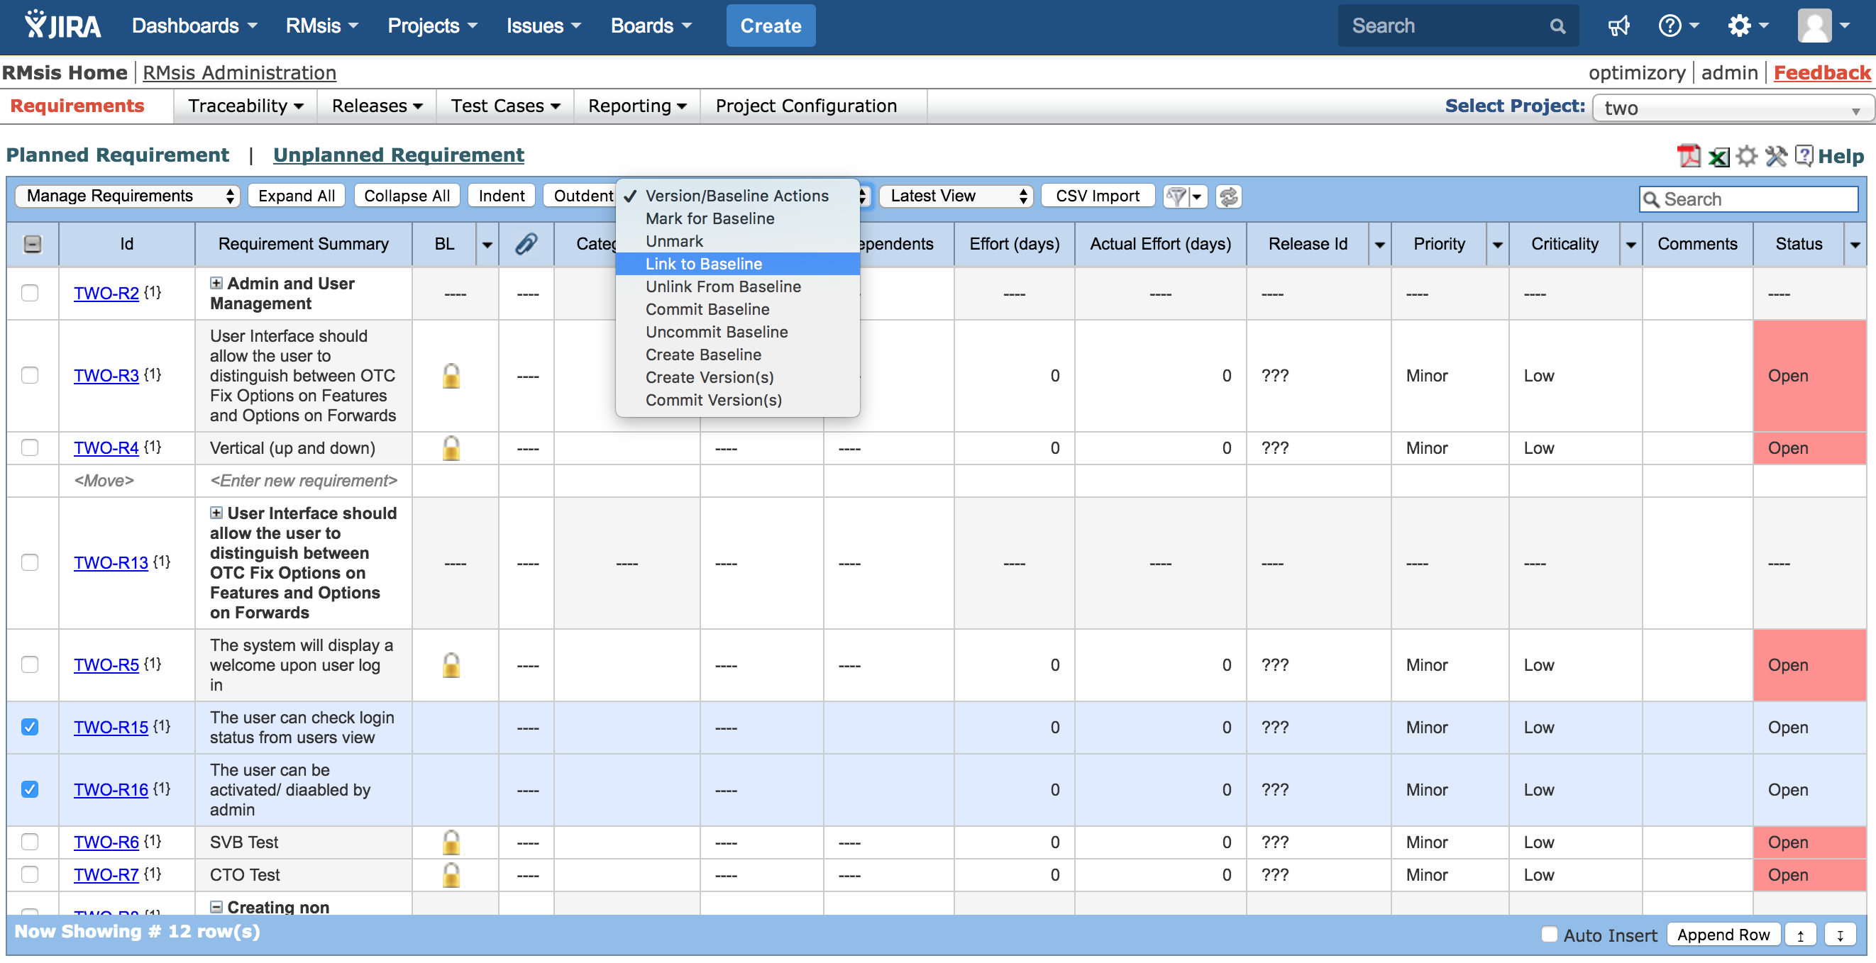
Link to Baseline
Click on Link to Baseline Option

Slide 18
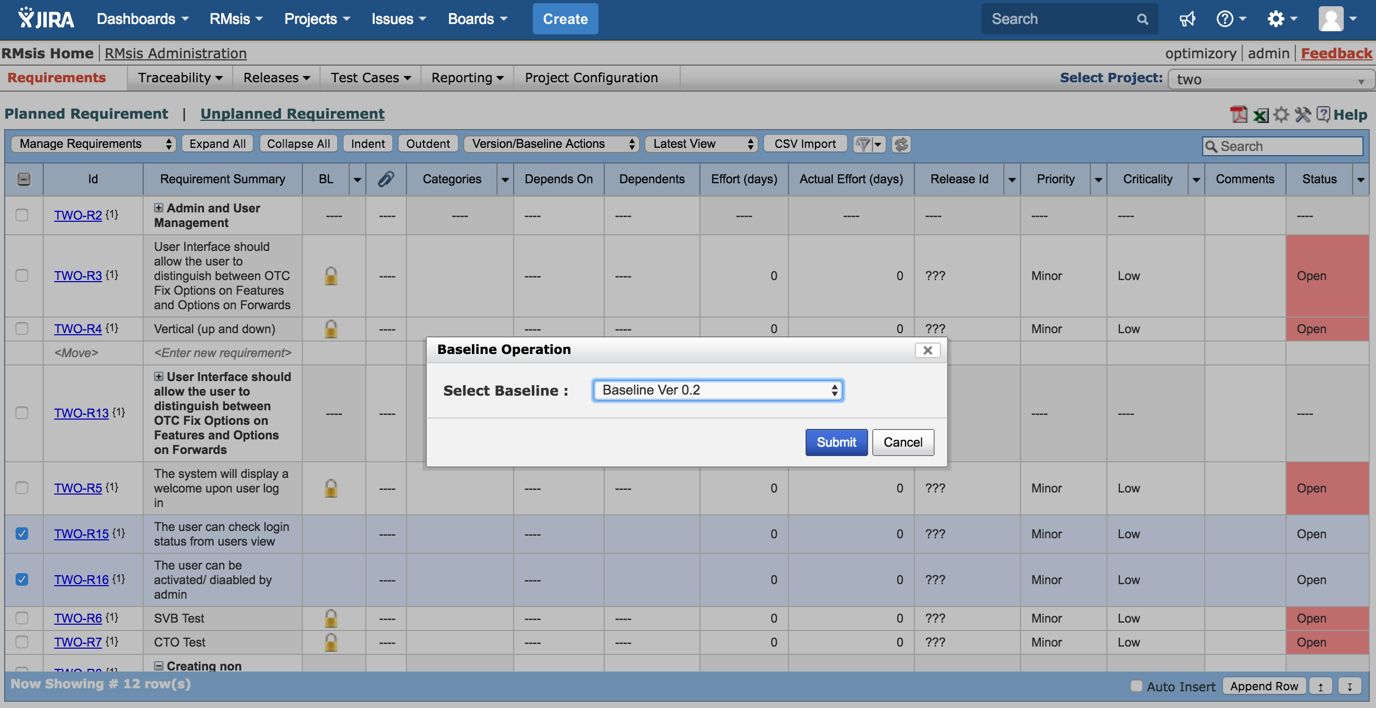
Select Baseline
Select Baseline to which requirements need to be linked with

Slide 19
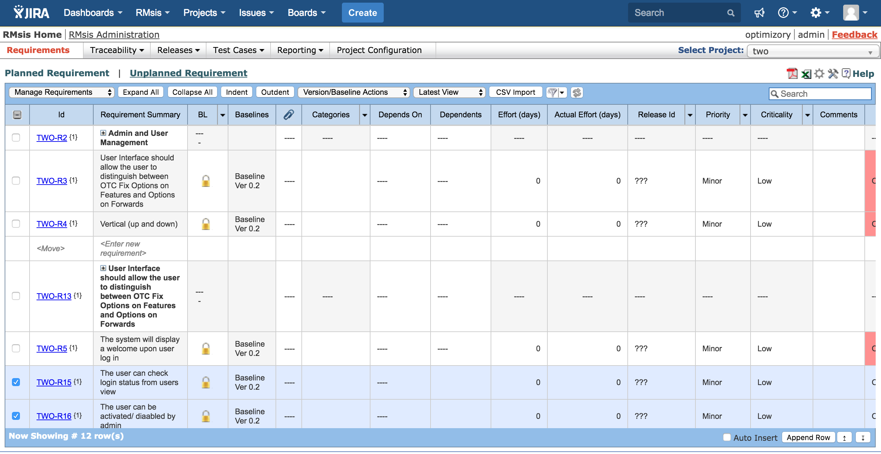
Requirements linked with baseline
Finally the requirements will be linked with the selected baseline

Slide 20
View Baseline

Slide 21
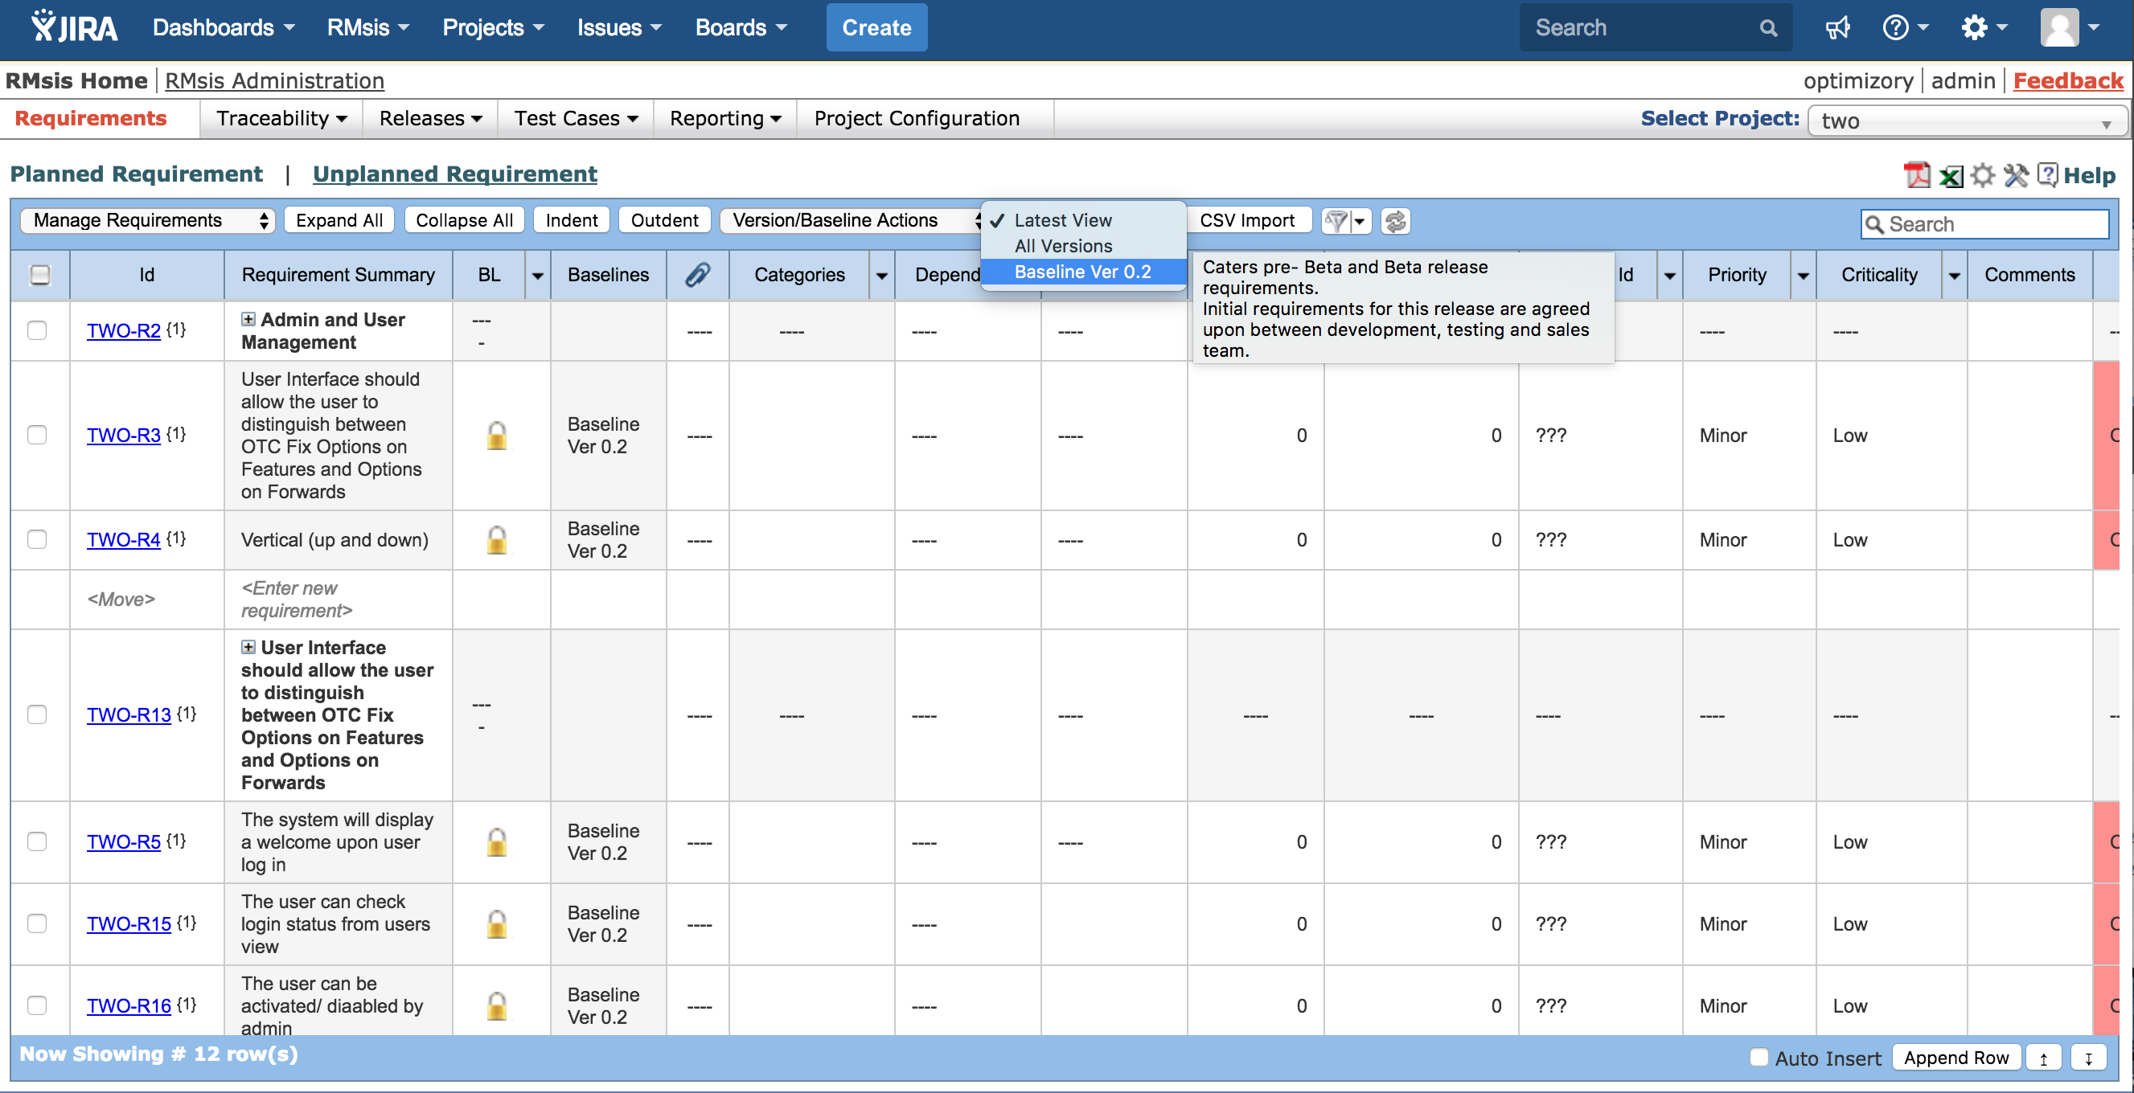
View Previous Baselines

Slide 22
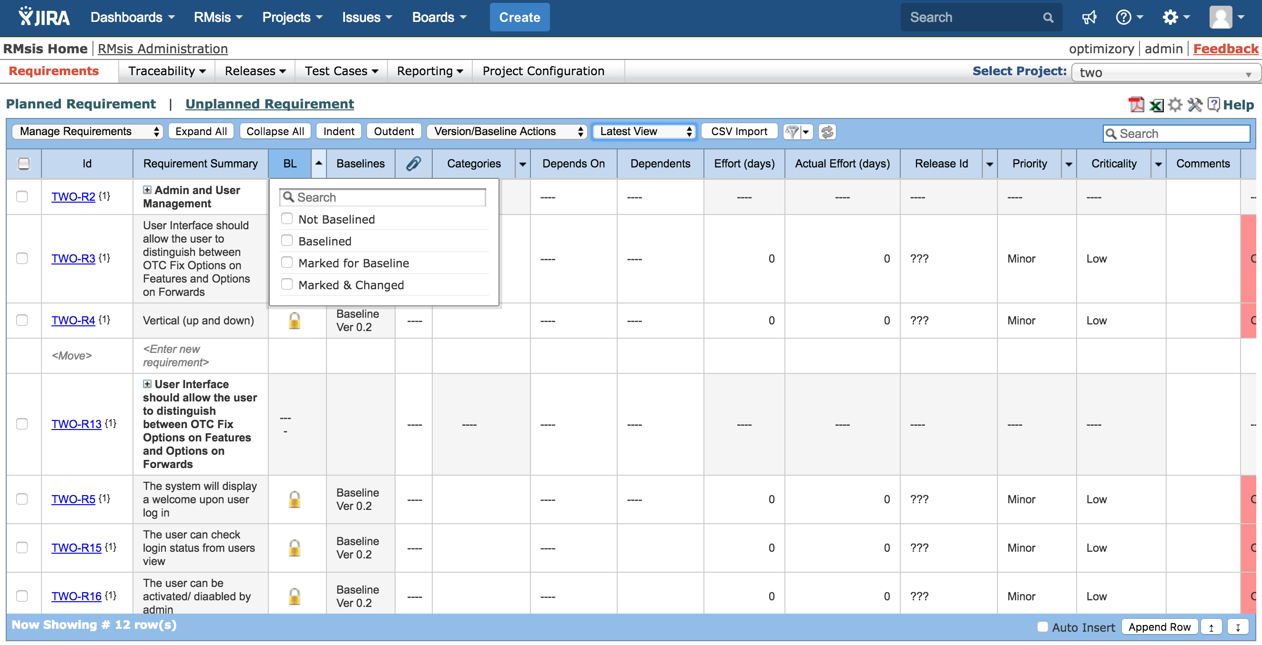
Filter can be applied on BL column

Slide 23
More Information

Slide 24
See Also ..
RMsis Home
  http://products.optimizory.com/rmsis
RMsis Documents
  Latest Release : http://docs.optimizory.com/display/rmsis/RMsis+Documentation+-+Latest+Release
  Preview of latest features : http://docs.optimizory.com/display/preview/Home
  Functions included in Releases : http://docs.optimizory.com/display/rmsis/Summary+of+RMsis+Releases
RMsis at Atlassian
  https://marketplace.atlassian.com/plugins/com.optimizory.rmsis.plugin.jira-rmsis/server/overviewRMsis Demo link
RMsis Demo link
  http://jira-rmsis.optimizory.com/
    Project manager login details
      Login: pm1
      Password: project123
    Team member login details
      Login: usr1
      Password: user123

Slide 25
Thanks!
For further questions or issues, contact support@optimizory.com
Notes:
Thanks for your time and interest !
Finally, we want to ensure that we build products, which really solve your problems.
So, if you have any open issues, please feel free to contact our support team.

