Slide 1
Versions, Branching and Baseline in RMsis
Simplify Requirement Management for JIRA

Slide 2
Problem Statement
How to create and manage multiple versions in different branches of a Requirement ?
  Consider “Base Requirement 1”
  Need to develop and manage variants of this requirement for
    Solaris
    AIX
  While simultaneously working on releases
    Alpha
    Beta

Slide 3
Key Functions Used
Views in Planned Table
  Latest View : To add new requirements.
  All versions : To view all versions of a requirement and to create branches.
Create Version (of a requirement)
Commit Version (of a requirement)

Slide 4
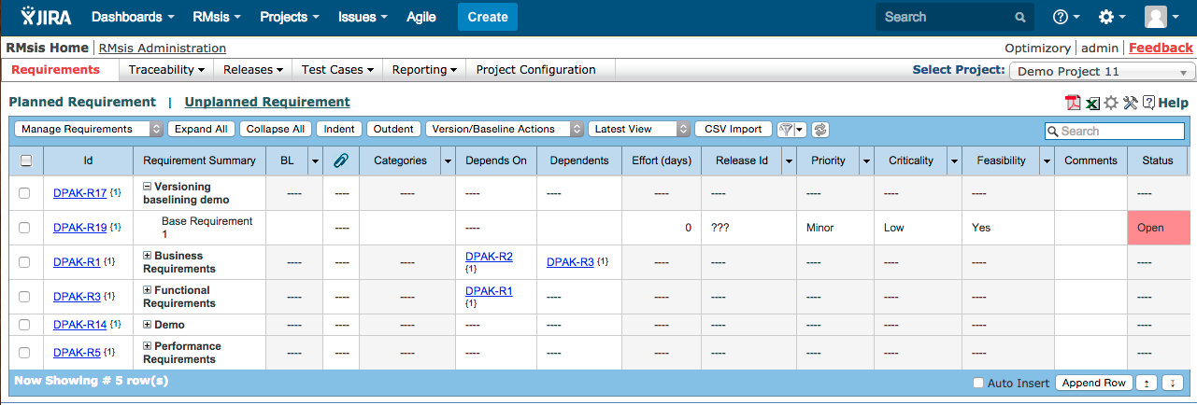
Create the “Base Requirement 1”
This would be in an “Editable Mode”
Let the requirement evolve…

Slide 5
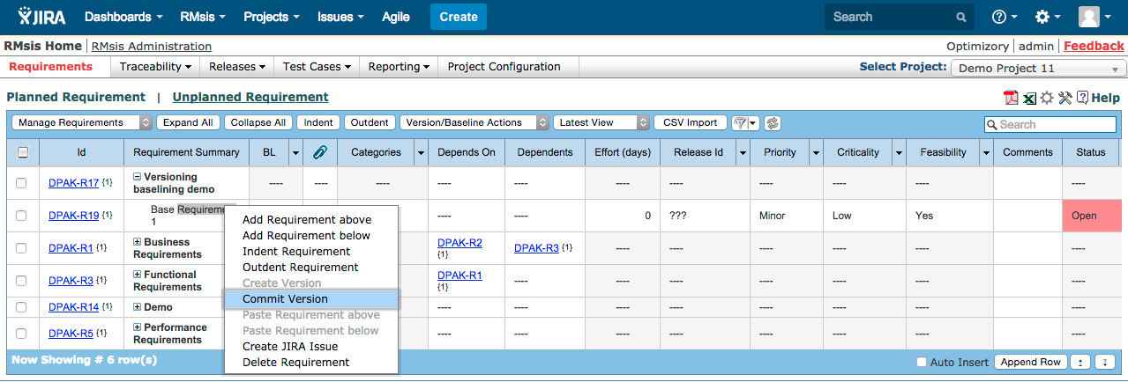
When the requirement has completely evolved, Commit Version (saved as Version 1).

Slide 6
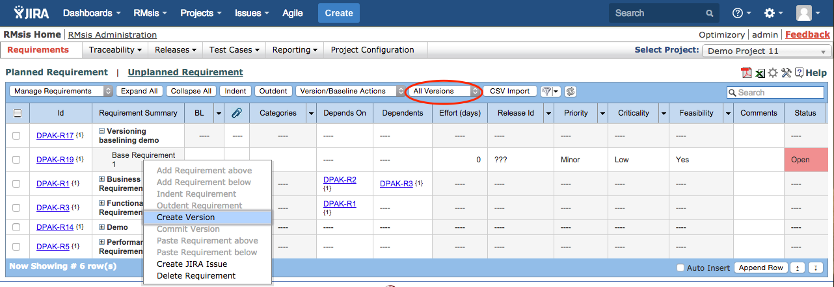
Create a version for Platform AIX.
This will lead to creation of a Branch.
Note
  All versions view is selected
  The description of Version 2 is modified in the next slide.

Slide 7
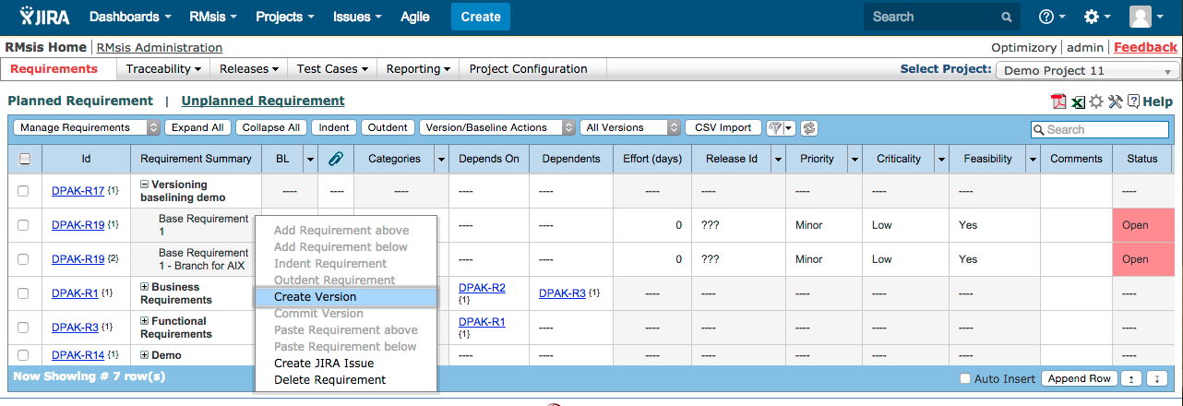
Create another version for Platform Solaris.
This will lead to creation of another Branch.

Slide 8
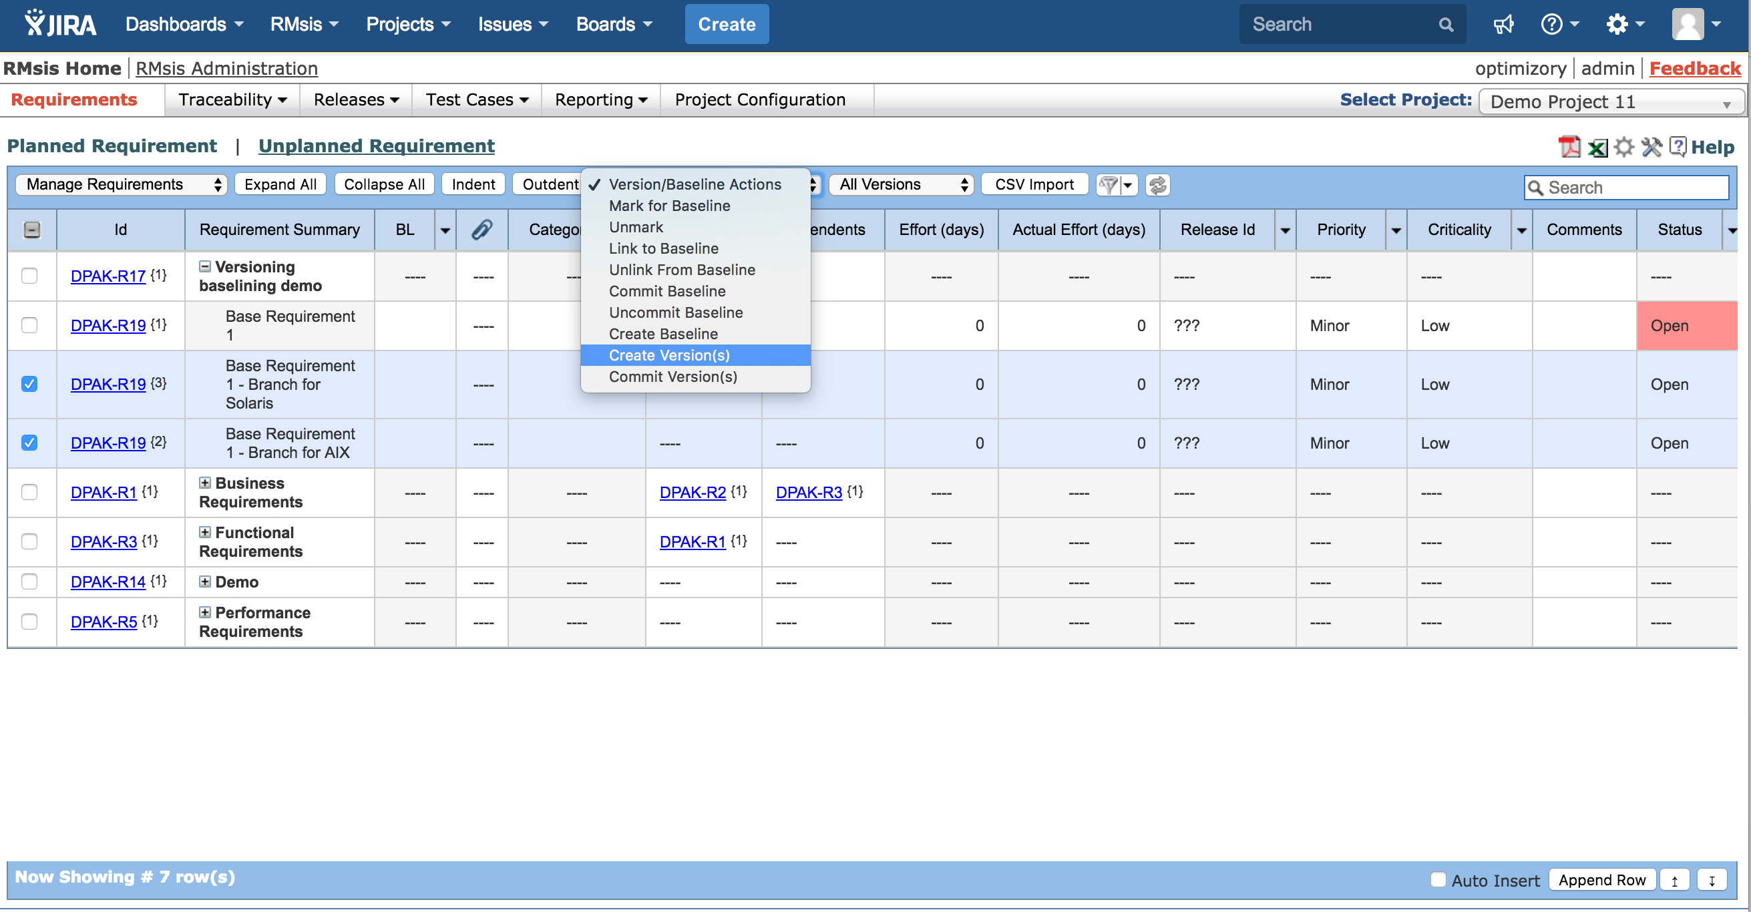
Commit the versions, after they are completely defined.

Slide 9
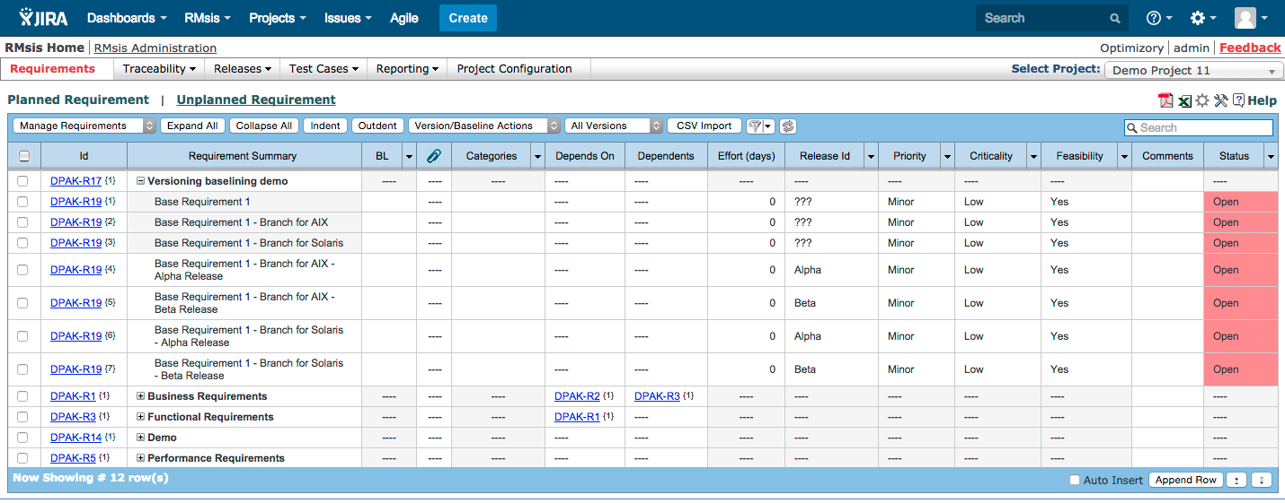
Create versions for Alpha and Beta releases in “Editable Mode”.

Slide 10
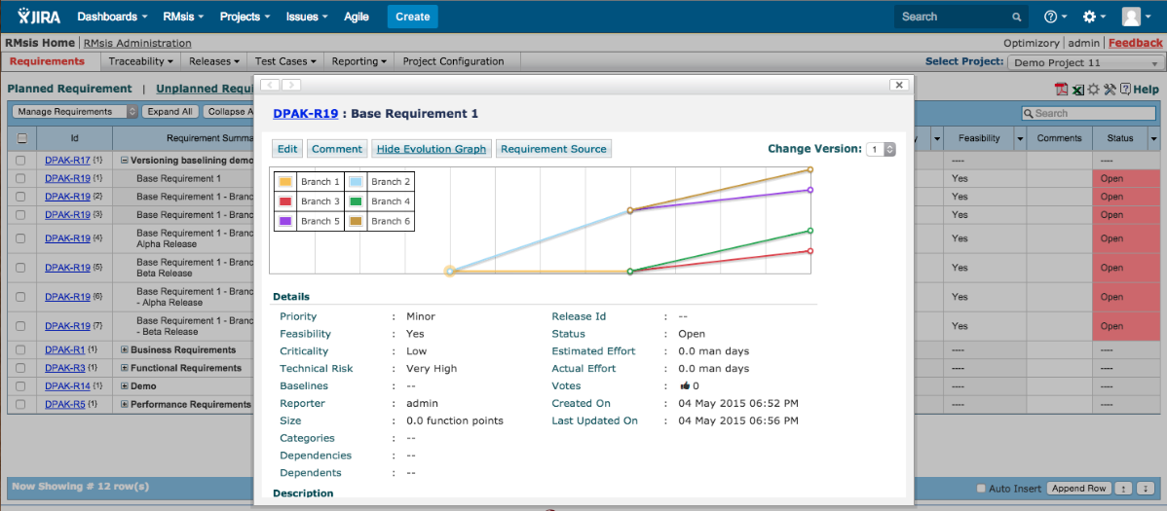
All branches and versions can be viewed by clicking on the “Show Evolution Graph” within the detailed view of a requirement.

Slide 11
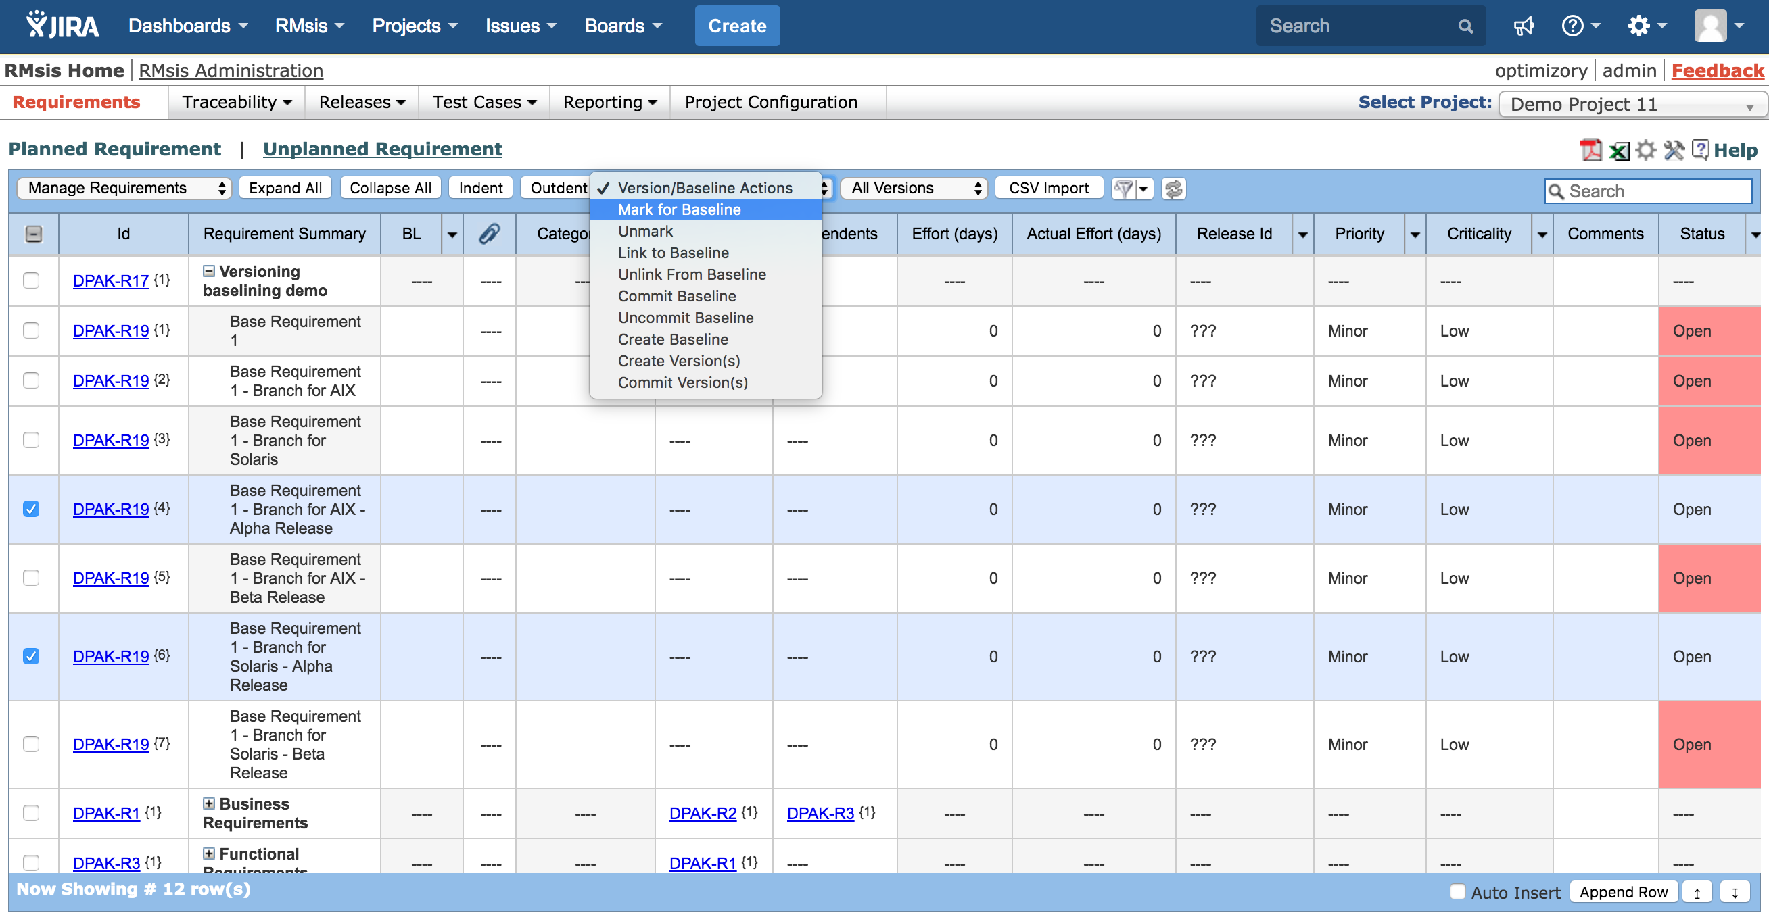
For all requirements that are frozen, “Mark for Baseline”.

Slide 12
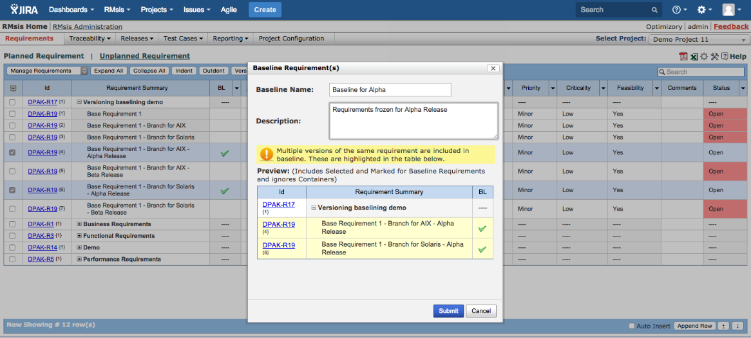
When all requirements for a Baseline are finalized, create the baseline, named “Baseline for Alpha”.

Slide 13

The final “Baselined” set of requirements for Alpha release.

Slide 14
See Also ..
RMsis Home
  http://products.optimizory.com/rmsis
RMsis Documents
  Latest Release : http://docs.optimizory.com/display/rmsis/RMsis+Documentation+-+Latest+Release
  Preview of latest features : http://docs.optimizory.com/display/preview/Home
  Functions included in Releases : http://docs.optimizory.com/display/rmsis/Summary+of+RMsis+Releases
RMsis at Atlassian
  https://marketplace.atlassian.com/plugins/com.optimizory.rmsis.plugin.jira-rmsis/server/overview
RMsis Demo link
  http://jira-rmsis.optimizory.com/
    Project manager login details
      Login: pm1
      Password: project123
    Team member login details
      Login: usr1
      Password: user123

Slide 15
Thanks!
For further questions or issues, contact support@optimizory.com
Notes:
Thanks for your time and interest !
Finally, we want to ensure that we build products, which really solve your problems.
So, if you have any open issues, please feel free to contact our support team.

