Slide 1
Lifecycle of a Requirement in
Product Development Scenario
Simplify Requirement Management for JIRA
Notes:
This presentation provides a short overview of RM sis.

Slide 2
Problem Statement
To walk through the lifecycle of a specific Requirement in a product development scenario.
A need is contributed by customer, eventually leading to inclusion as feature.
  Need is specified in unplanned table.
  Requirement is included in the planned set, analyzed and assigned to a release.
  Requirement is evolved and baselined.
  Requirement goes through a change request.
  It is implemented and tested.
  Forward traceability is established.
  Issues are associated and tracked to closure.

Slide 3
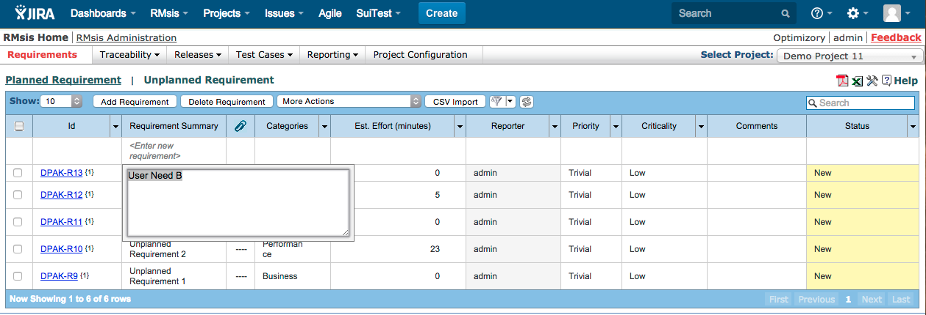
“Customer Need B” is contributed by a customer / team member in “Unplanned Table”.

Slide 4
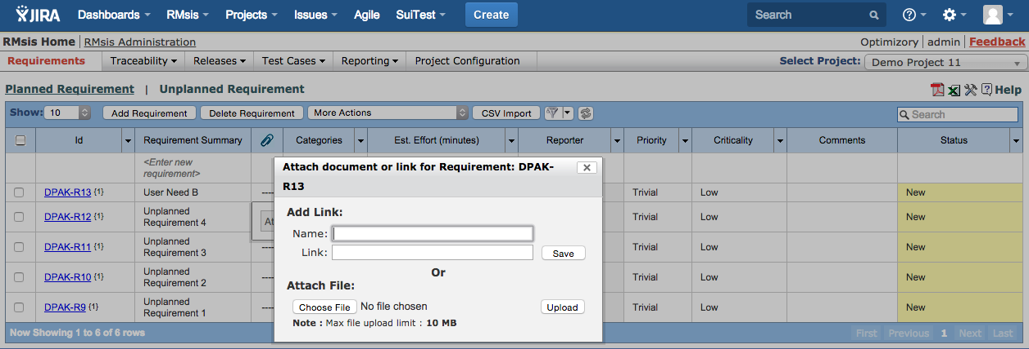
The need is elaborated by the contributor / Business Analyst / Product Manager.

Slide 5
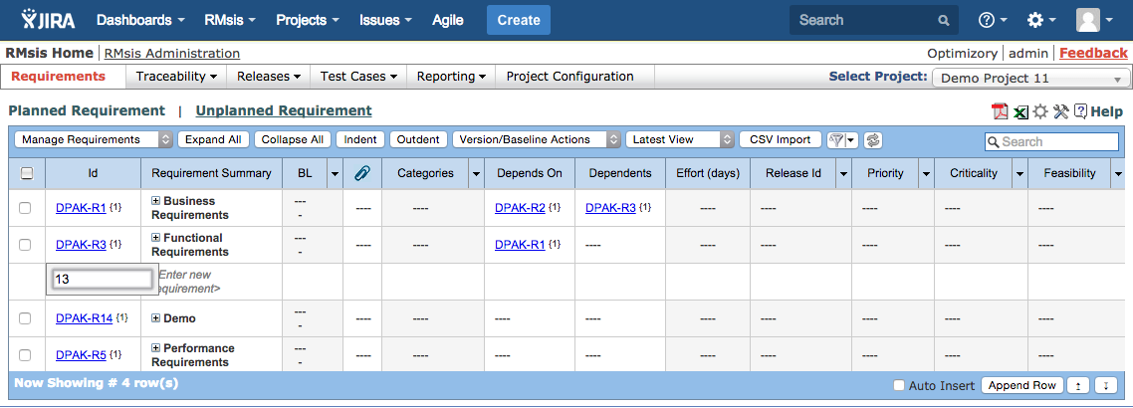
Product Manager identifies this as a valuable input and decides to move it to the Planned Requirements list.

Slide 6
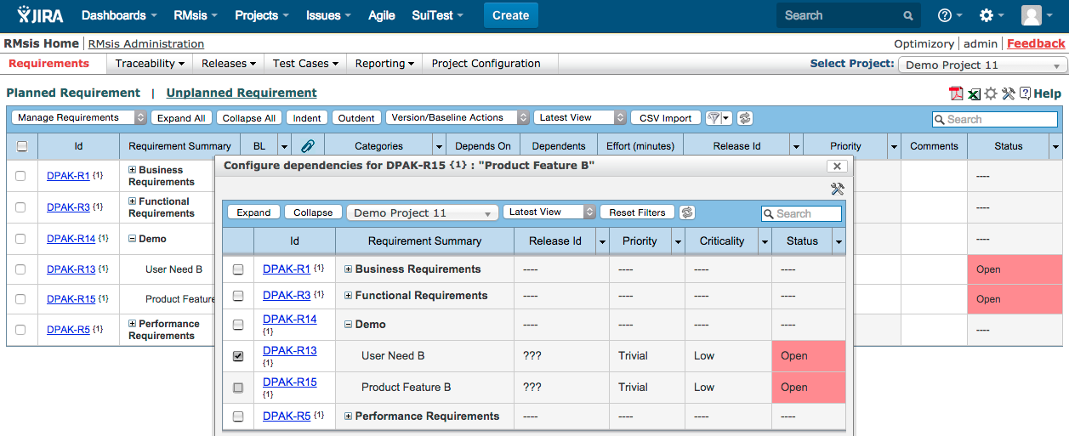
Product Management Team
  defines a “Feature B” and creates dependency on need.
  can also define a requirements hierarchy, like
    User Need >> Product Function >> Feature

Slide 7
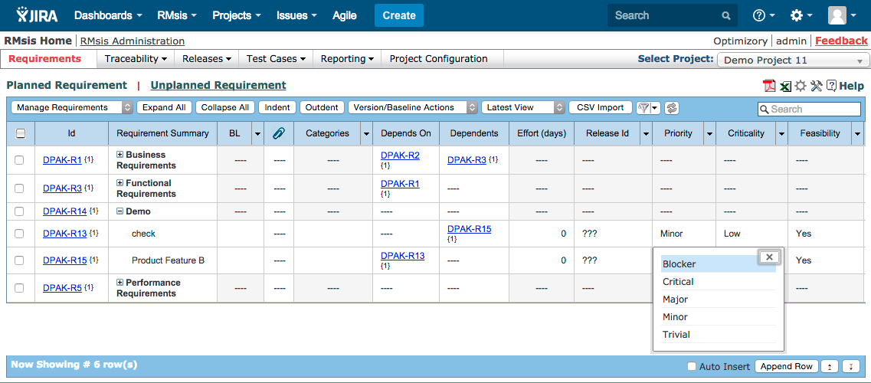
This Feature is analyzed by the Product Management Team, who does an estimation and assigns values to various attributes.

Slide 8
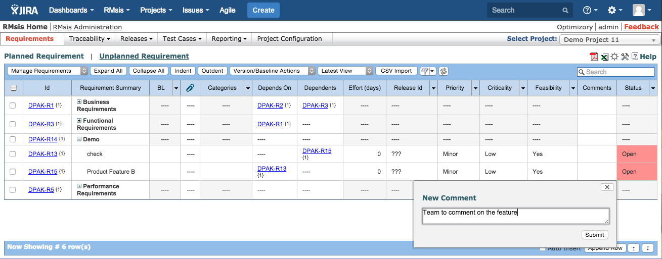
The Feature is opened up to a multidimensional team (sales, developers, architects) for comments.
The team’s feedback is incorporated.

Slide 9
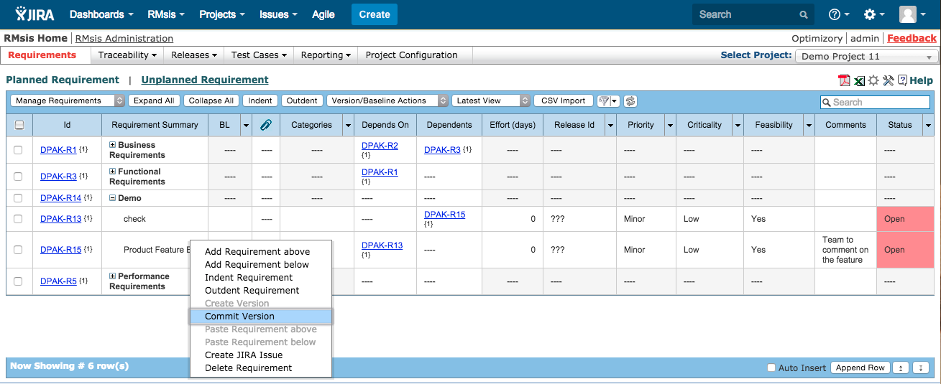
When the evolution of “feature B” stops, it’s current version is committed.

Slide 10
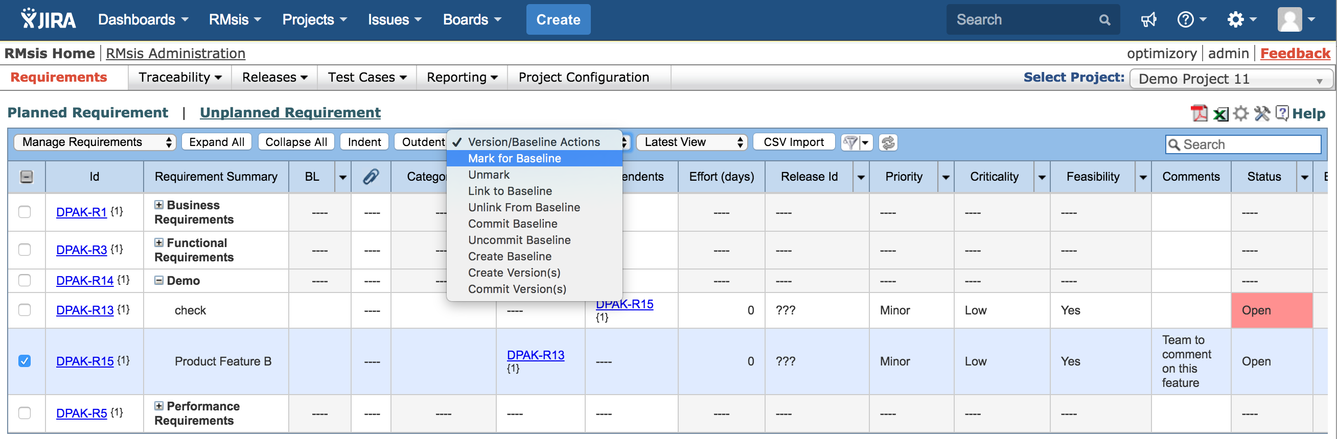
The feature can be Baselined / Marked for Baseline.

Slide 11
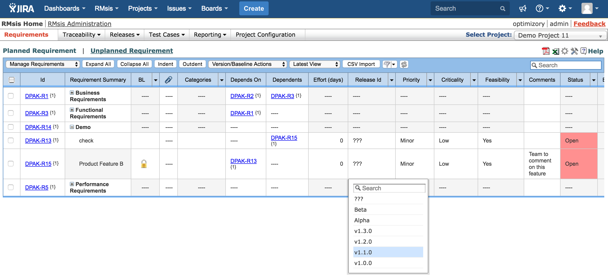
The feature is assigned to product release “v1.0.0”.

Slide 12
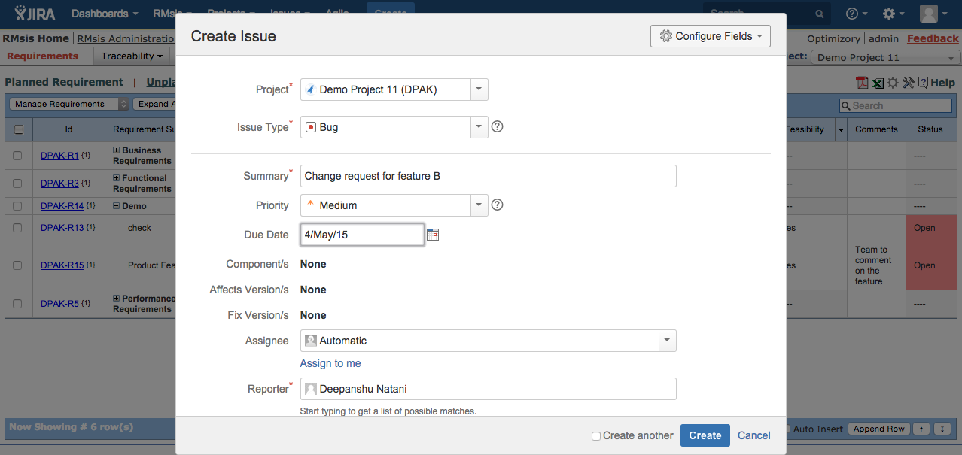
Development Team starts developing Feature B.
Test Team starts preparing for testing of Feature B.
They discover an issue and log a change request.

Slide 13
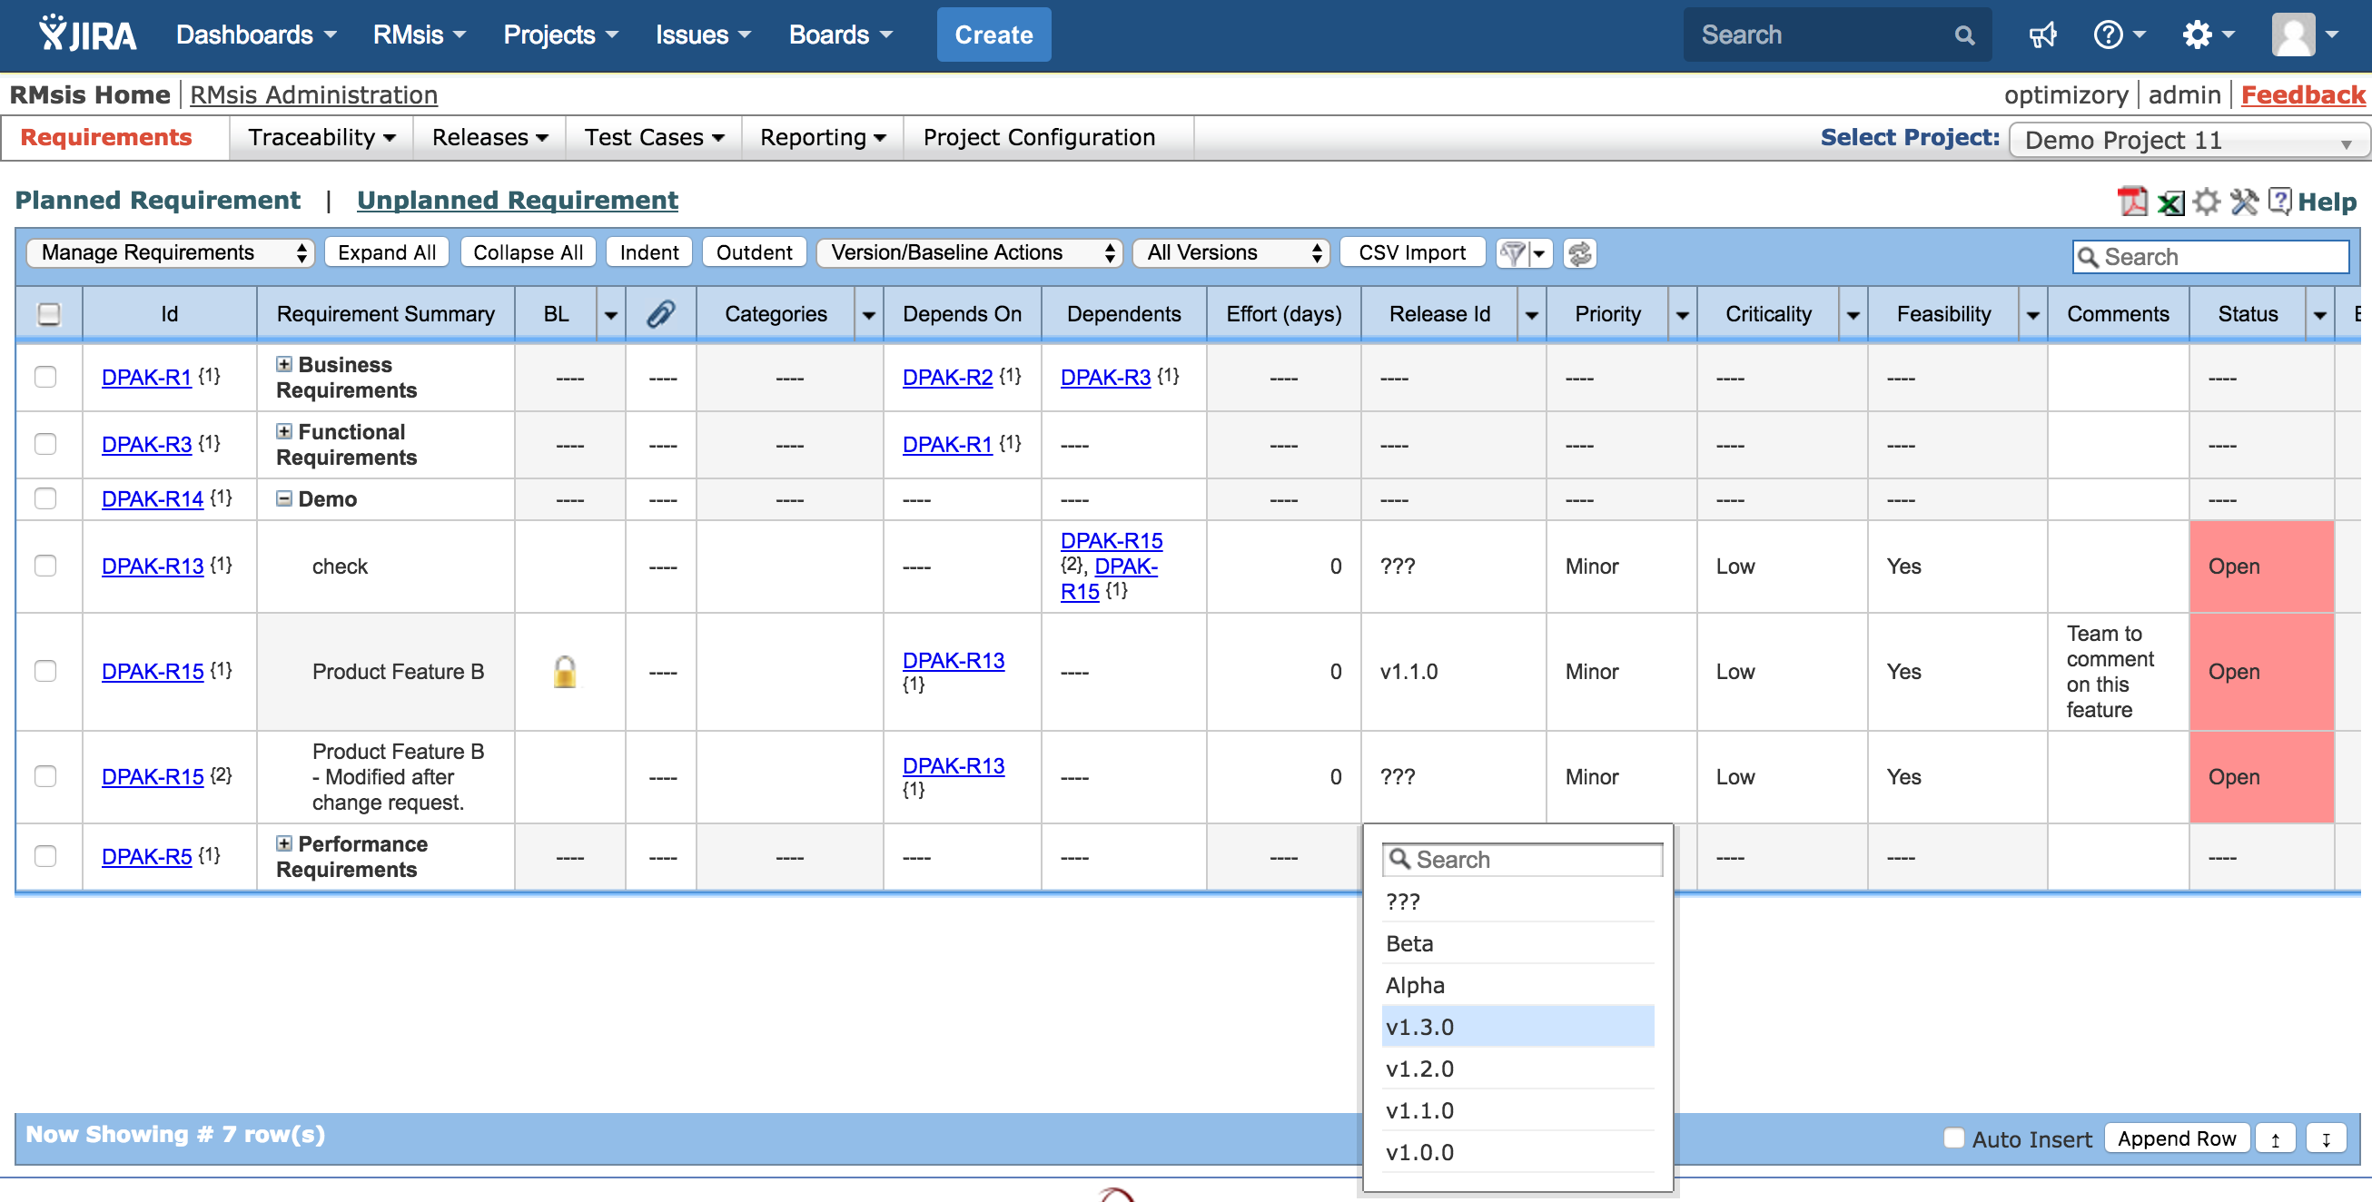
Change request is closed.
Feature is updated and a new version (2) created.
This version is assigned to Release v1.3.0.

Slide 14
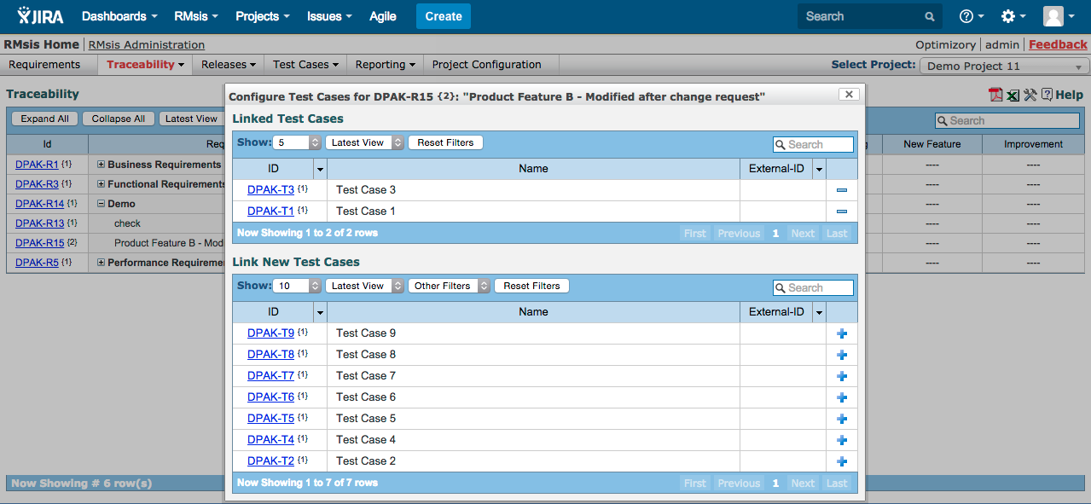
Test Cases are mapped to the requirement.

Slide 15
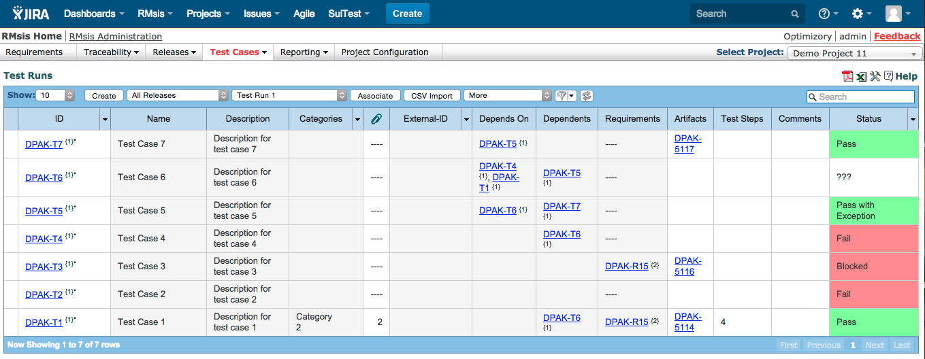
Create Test Run(s) and execute

Slide 16
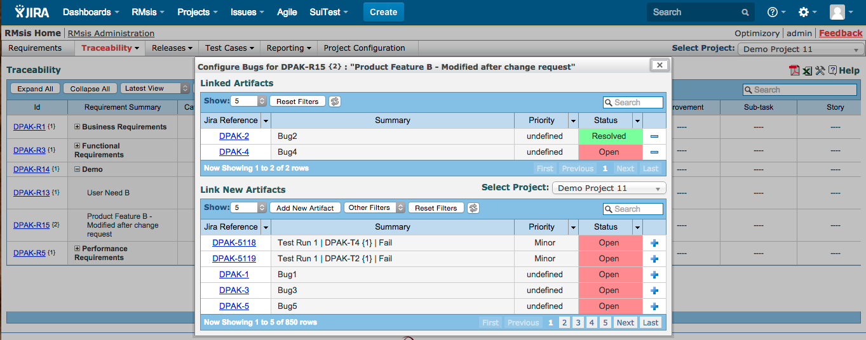
Issues found during testing are mapped to the requirement.
These issues are tracked to closure.

Slide 17
The “Product Feature B” is released as part of
Release v1.3.0

Slide 18
See Also ..
RMsis Home
  http://products.optimizory.com/rmsis
RMsis Documents
  Latest Release : http://docs.optimizory.com/display/rmsis/RMsis+Documentation+-+Latest+Release
  Functions included in Releases : http://docs.optimizory.com/display/rmsis/Summary+of+RMsis+Releases
RMsis at Atlassian
  https://marketplace.atlassian.com/plugins/com.optimizory.rmsis.plugin.jira-rmsis/server/overview
RMsis Demo link
  http://jira-rmsis.optimizory.com/
    Project manager login details
      Login: pm1
      Password: project123
    Team member login details
      Login: usr1
      Password: user123

Slide 19
Thanks!
For further questions or issues, contact support@optimizory.com
Notes:
Thanks for your time and interest !
Finally, we want to ensure that we build products, which really solve your problems.
So, if you have any open issues, please feel free to contact our support team.

