Slide 1
Installing RMsis
Simplify Requirement Management for JIRA

Slide 2
Prerequisites for RMsis-2.x
Platforms supported by RMsis
Operating Systems | Microsoft Windows 7/8/10 Server 2008/Server 2012 Linux
JIRA | JIRA 6.0 to JIRA 8.2
Java Platform | Sun/Oracle JDK / JRE 1.7 and 1.8, AdoptJDK 8 Please make sure that you are running JVM in 64 bit mode, due to high memory requirements.
Databases | Postgres 8.4.0 or later MariaDB 5.5 series or 10.0 series SQL Server 2005/2008 /2012/ 2016 MySQL 5.1 or later Oracle 11g or later
Web Browsers | Firefox 3.5 or later, Internet Explorer 8.0 or later Chrome 11or later

Slide 3
Steps for Installation
Install JIRA (JIRA 6.0 to JIRA 8.2), if not already done so
Create database for RMsis
Install JIRA plugin for RMsis
  using JIRA Universal Plugin Manager
  Plugin is available as jira-rmsis.x.y.z.jar, where “x.y.z” is the version number
Activate License
Detailed Documentation: https://docs.optimizory.com/x/wYFZAQ

Slide 4
Ensure JIRA is installed
A stable and complete JIRA installation is prerequisite for RMsis installation.
We would like to recommend not using HSQLDB, since it can lead to data loss in case of abnormal termination.

Slide 5
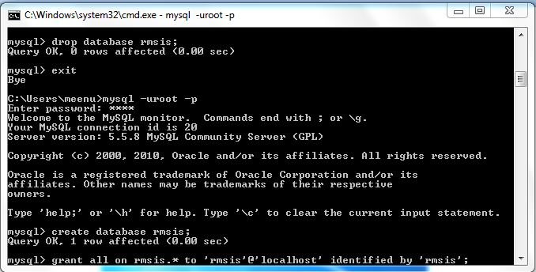
Create database
Login
Create database {say “rmsis”}
Grant permissions

Slide 6
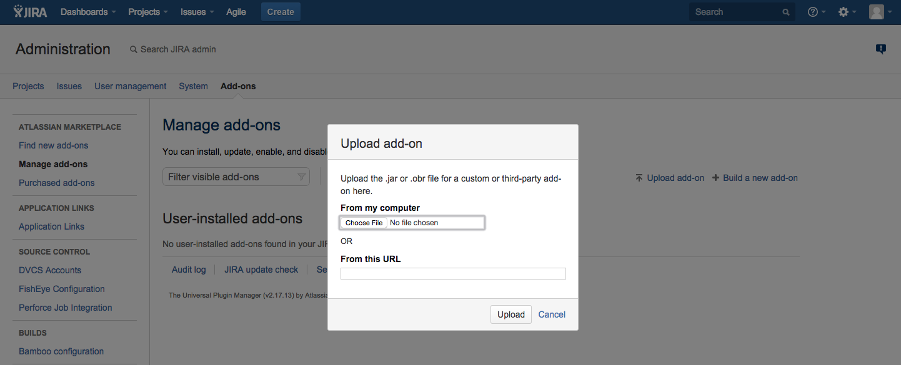
Install RMsis using JIRA Universal Plugin Manager
Get URL for the desired version of RMsis from http://products.optimizory.com/rmsis/download

Slide 7
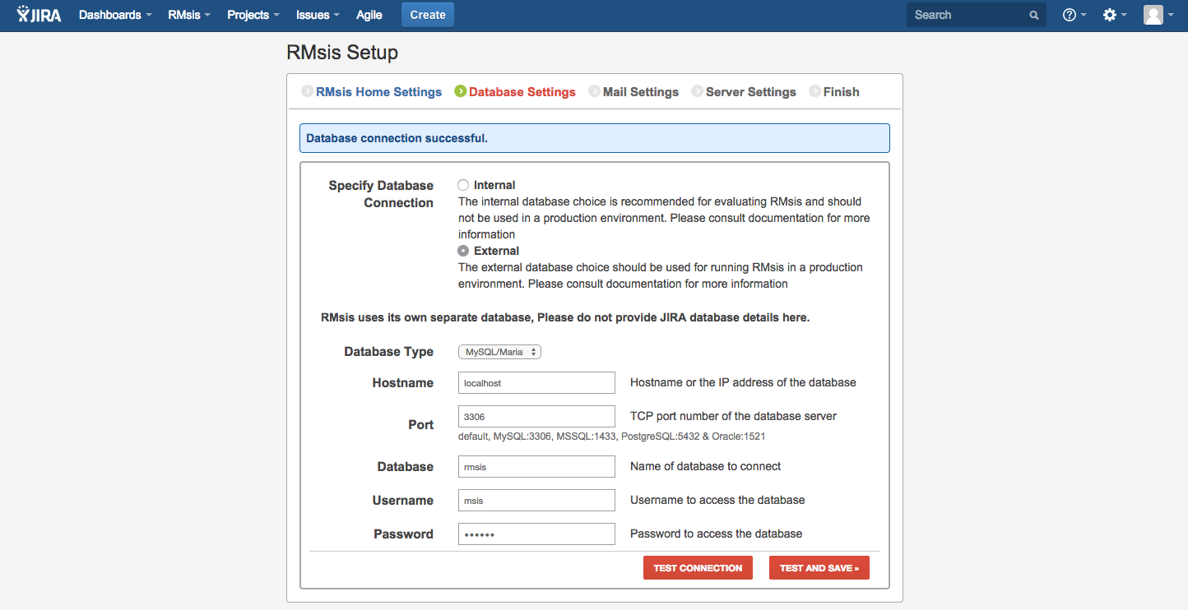
Configure the Database
Select Internal Database for Trials, for ease of setup.
For production systems, create a Database as suggested earlier.
Enter details here Test Connection with the Database.

Slide 8
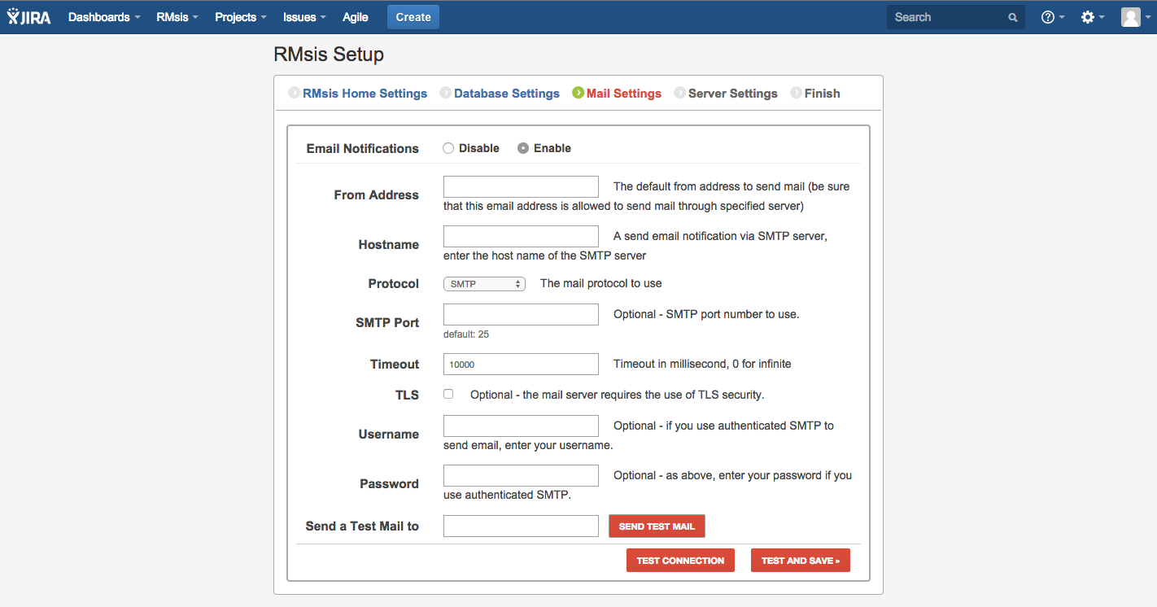
Configure Mail
This is optional.
If configured, Test Connection with mail server.

Slide 9
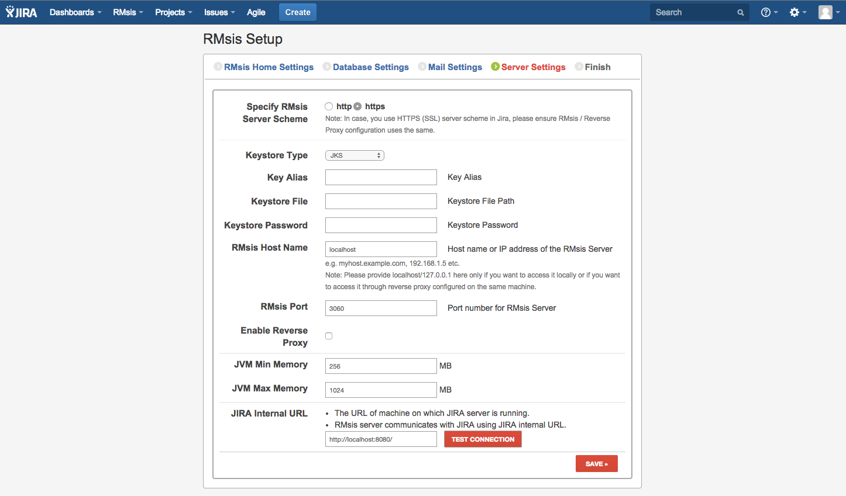
Configure RMsis Server
Both HTTP and HTTPS supported.
Configure JIRA Internal URL and Test Connection.
Optional Reverse Proxy support.
localhost is preferable for JIRA Internal URL

Slide 10
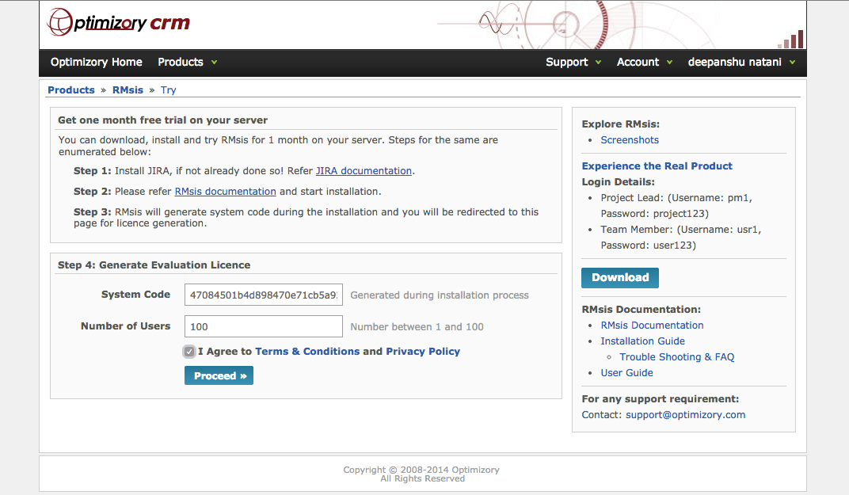
Generate and copy trial license from CRM
Login into crm.optimizory.com
Select number of users
Agree to Terms and Conditions and Privacy Policy
Click on proceed to generate trial license

Slide 11
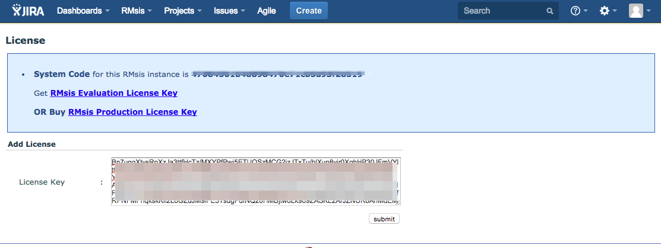
Paste license key in RMsis and click on “Submit” button

Slide 12
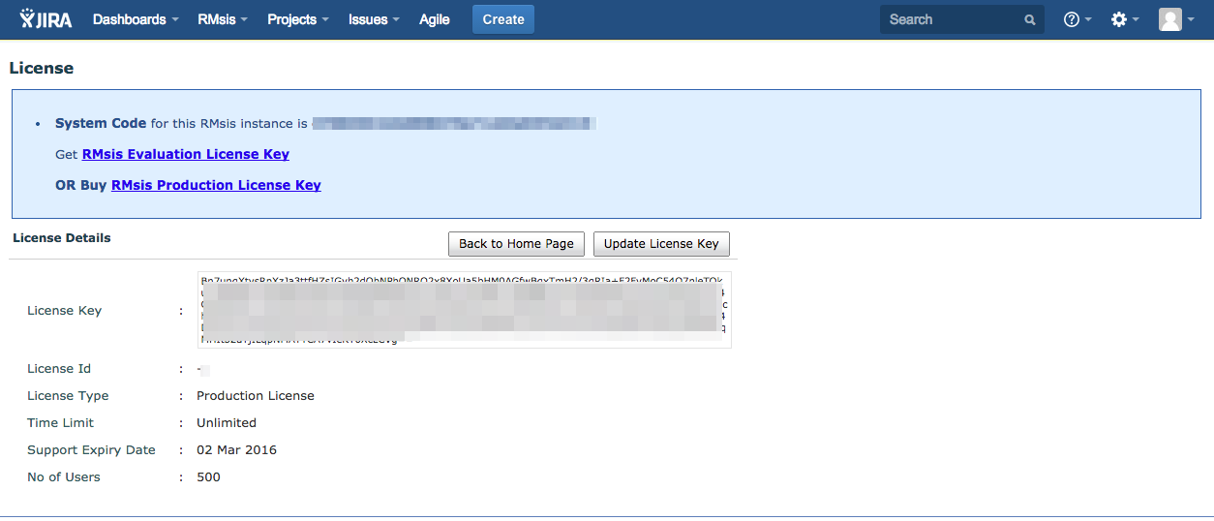
License expiry and type information will be displayed
Congratulations !!! You have activated license successfully !!

Slide 13
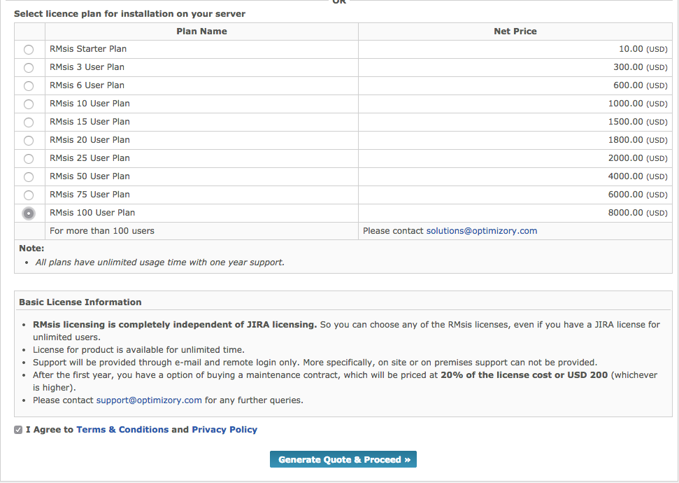
When you decide to Buy RMsis
Login into http://cart.optimizory.com/rmsis/buy
Select your license type
Agree to Terms and Conditions and Privacy Policy
On the next screen choose to pay through
  Paypal / 2Checkout
  Wire Transfer

Slide 14
See Also ..
RMsis Home
  http://products.optimizory.com/rmsis
RMsis Documents
  Latest Release : http://docs.optimizory.com/display/rmsis/RMsis+Documentation+-+Latest+Release
  Preview of latest features : http://docs.optimizory.com/display/preview/Home
  Functions included in Releases : http://docs.optimizory.com/display/rmsis/Summary+of+RMsis+Releases
RMsis at Atlassian
  https://marketplace.atlassian.com/plugins/com.optimizory.rmsis.plugin.jira-rmsis/server/overview
RMsis Demo link
  http://jira-rmsis.optimizory.com/
    Project manager login details
      Login: pm1
      Password: project123
    Team member login details
      Login: usr1
      Password: user123

Slide 15
Thanks!
For further questions or issues, contact support@optimizory.com
Notes:
Thanks for your time and interest !
Finally, we want to ensure that we build products, which really solve your problems.
So, if you have any open issues, please feel free to contact our support team.

