Slide 1
RMsis Overview
RMsis – v 1.5.0
now with JIRA 5.0 support
Simplify Requirement Management for JIRA

Slide 2
Introduction
RMsis is simplified requirement management product, designed specially to complement JIRA
Helps Manage
  Requirement Lifecycle
    Versions and Baselines of Requirements
  Forward and Reverse Traceability of
    Requirements, Issues and Test Cases
  Releases
    and their association with Requirements, Issues and Test Cases
  Test Case Lifecycle
  Test Runs

Slide 3
Users
Default Roles
  Administrator
    Acts like a Tool Admin. By default, does not have access to Project Data.
  Product Manager
    Owner of Requirements in the Project
    Also referred as Project | Requirement Manager
  Analyst
  Team Member
  Customer
  Test Manager
  Testing Team Member
  Tester
Permissions given to Default Roles can be changed by Administrator.
Custom Roles can be defined by Administrator.

Slide 4
Overview of Features and Functions

Slide 5
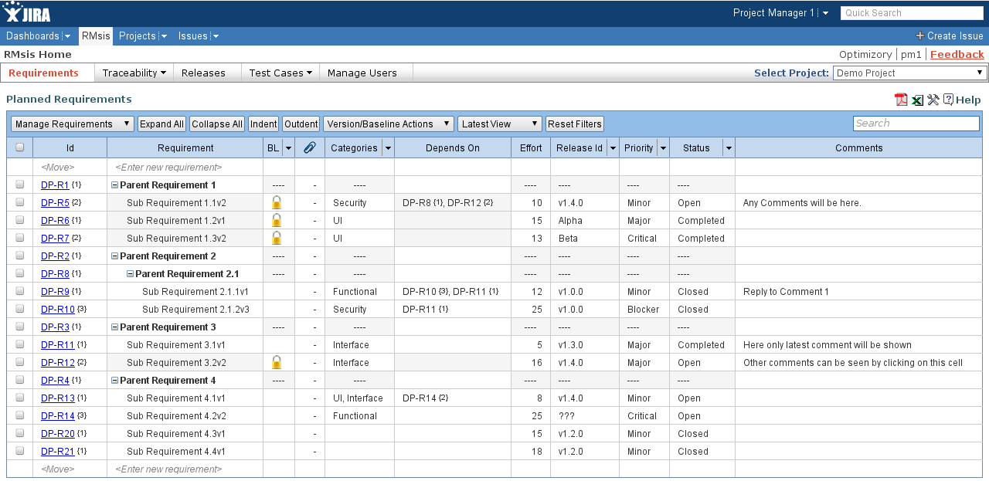
Requirements Management Screen
Add requirements and set their attributes.

Slide 6
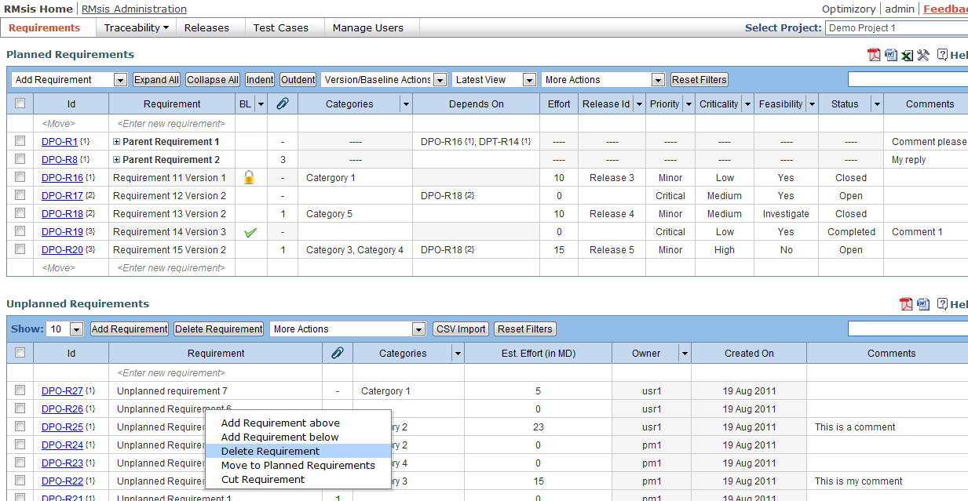
Analyze and Move Requirements from Unplanned to Planned Table

Slide 7
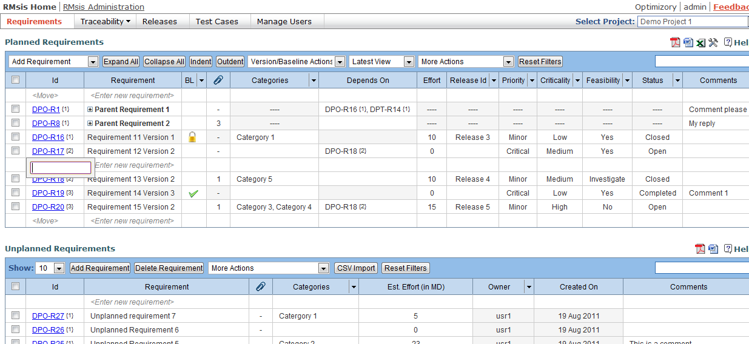
Movement of Requirement within Planned Requirement
Right click on the requirement
Select add requirement above/below
Enter requirement ID to move

Slide 8
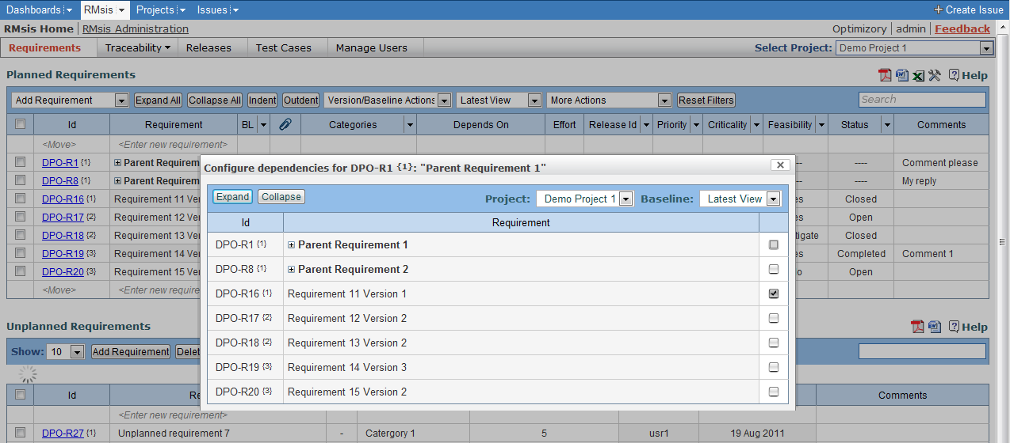
Requirement Dependencies
Add requirement dependencies
RMsis automatically takes care of cyclic dependencies

Slide 9
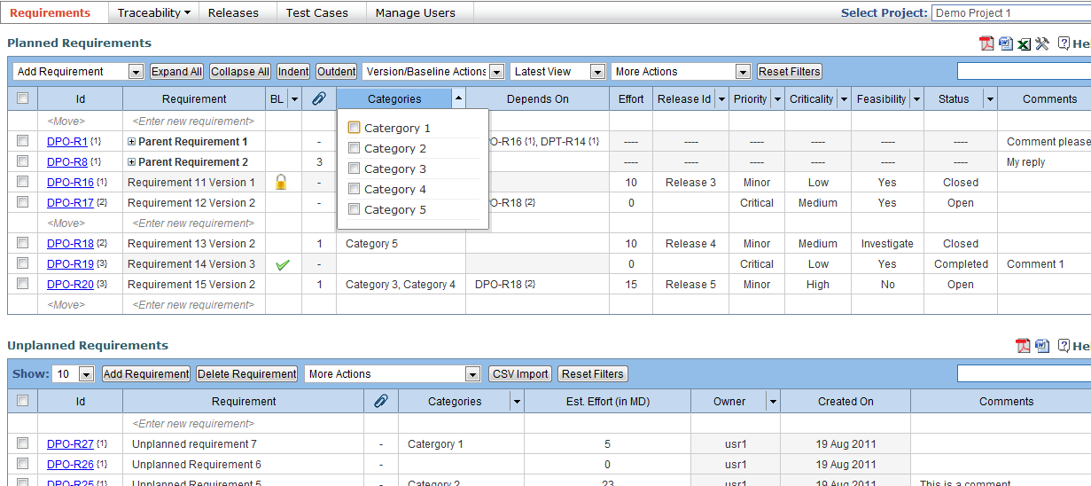
Filters
Use various filters to access the relevant information.

Slide 10
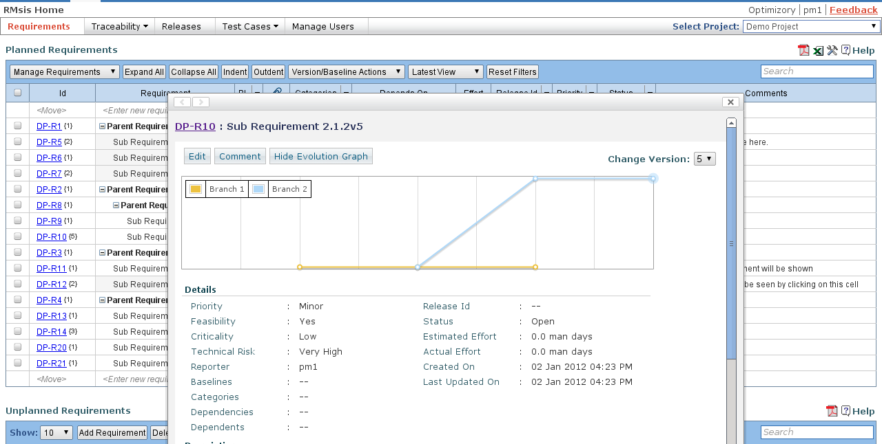
Editing Requirements
Requirement manager can view and edit details of a requirement.

Slide 11
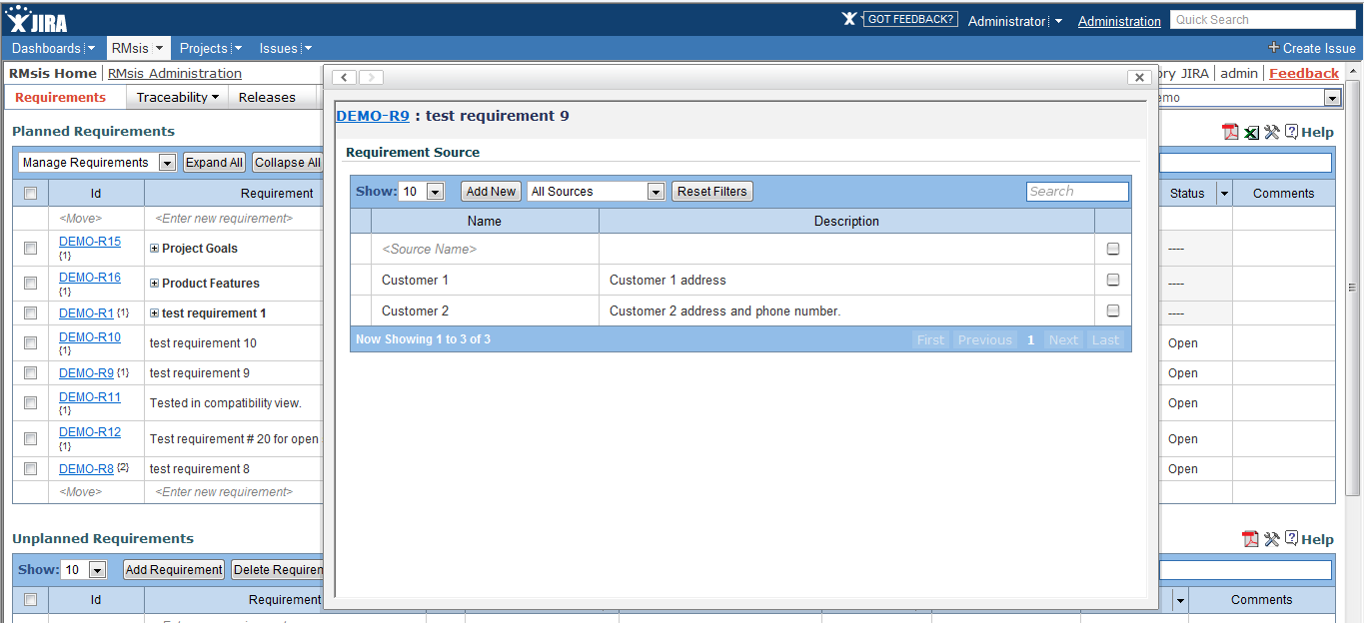
Specify source of a Requirement
RMsis maintains a list of sources
A requirement can be mapped to a source

Slide 12
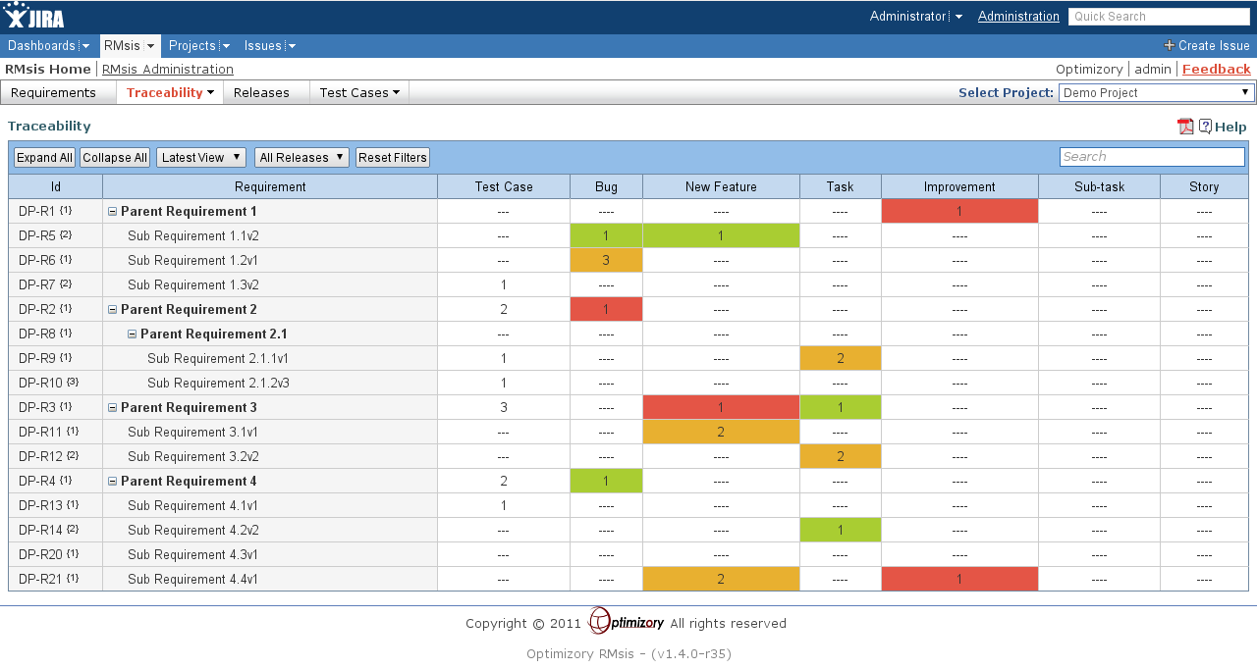
Requirement Traceability
View traceability of issues/bugs/tasks against requirements.
Any custom type of JIRA issue can be traced.

Slide 13
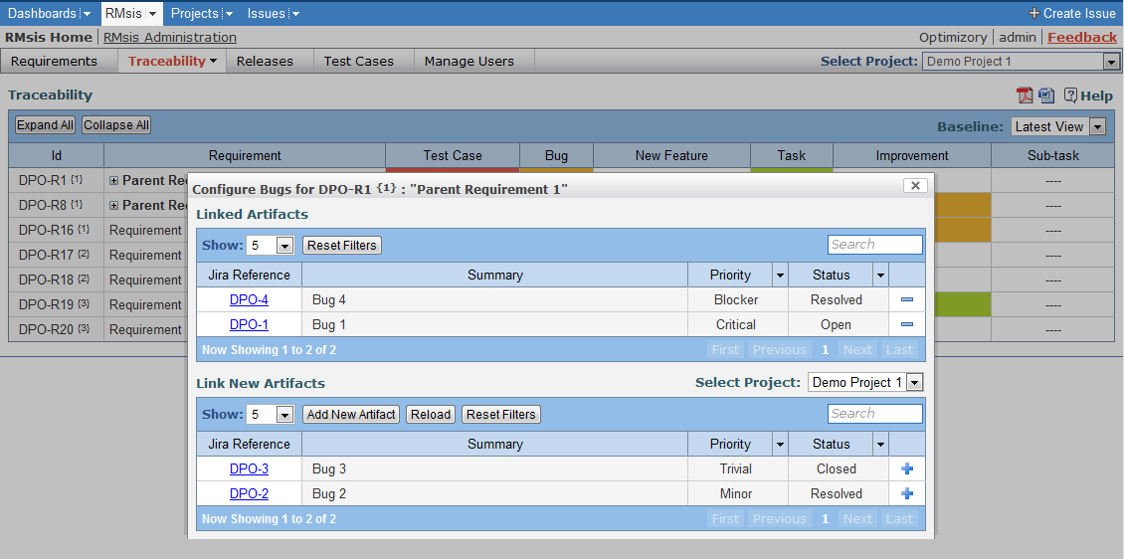
Traceability: Linking Issues
Already linked issues can be viewed and new issues can be added.

Slide 14
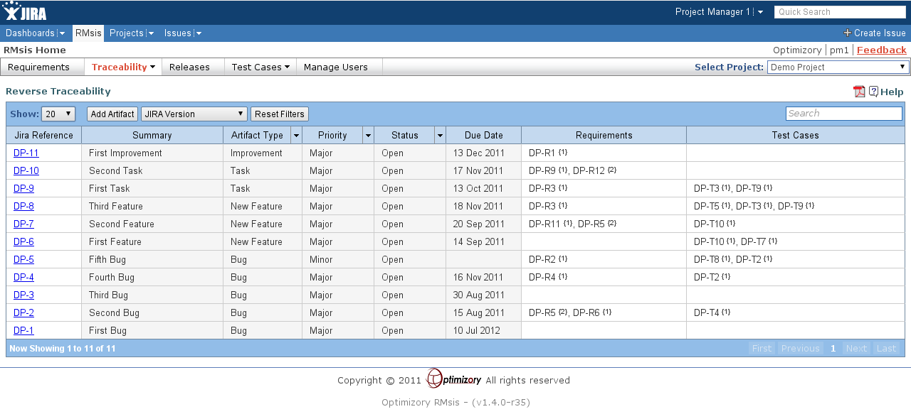
Reverse Traceability
View status of all the issues associated with a Release
View Requirements and Test cases associated with any given JIRA issue
This view effectively points to the health of a Release

Slide 15
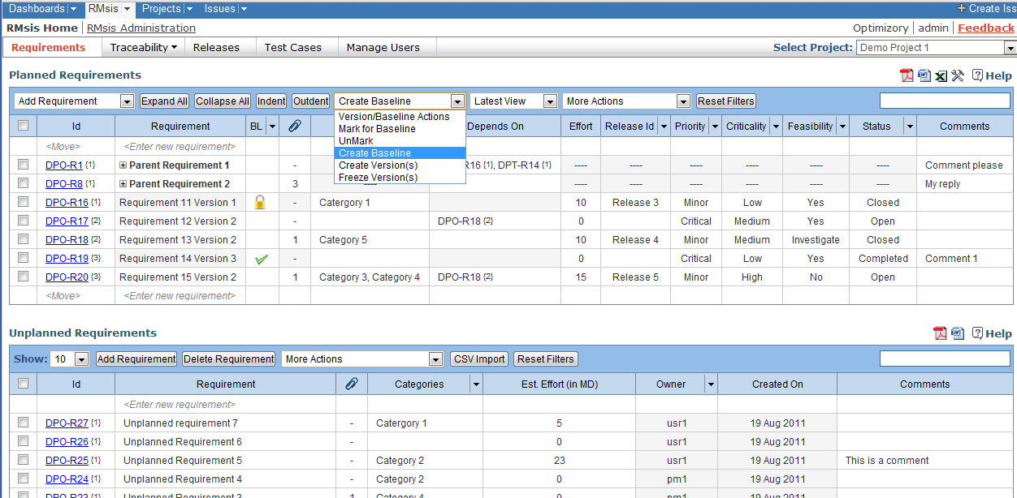
Baseline: Select Requirement(s) to Mark for Baseline
Manager can mark requirement for baseline after discussion.

Slide 16
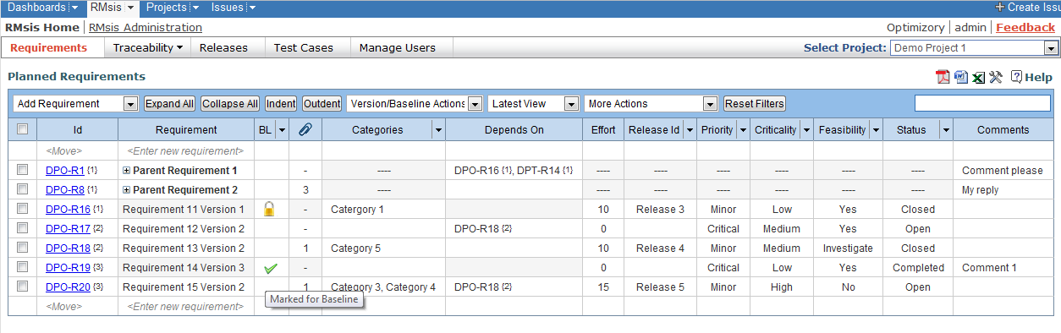
Baseline: Marked for Baseline

Slide 17
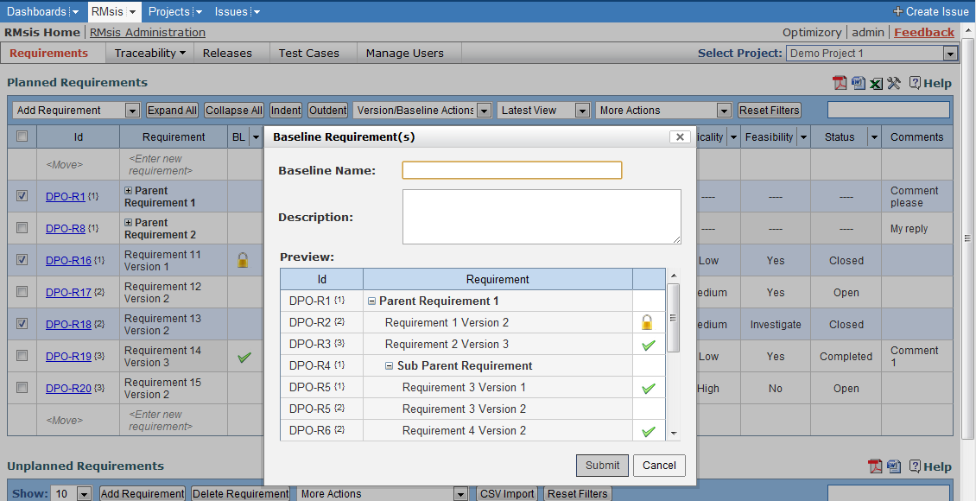
Baseline: Create Baseline
Manager can create baseline and provide a name to it.

Slide 18
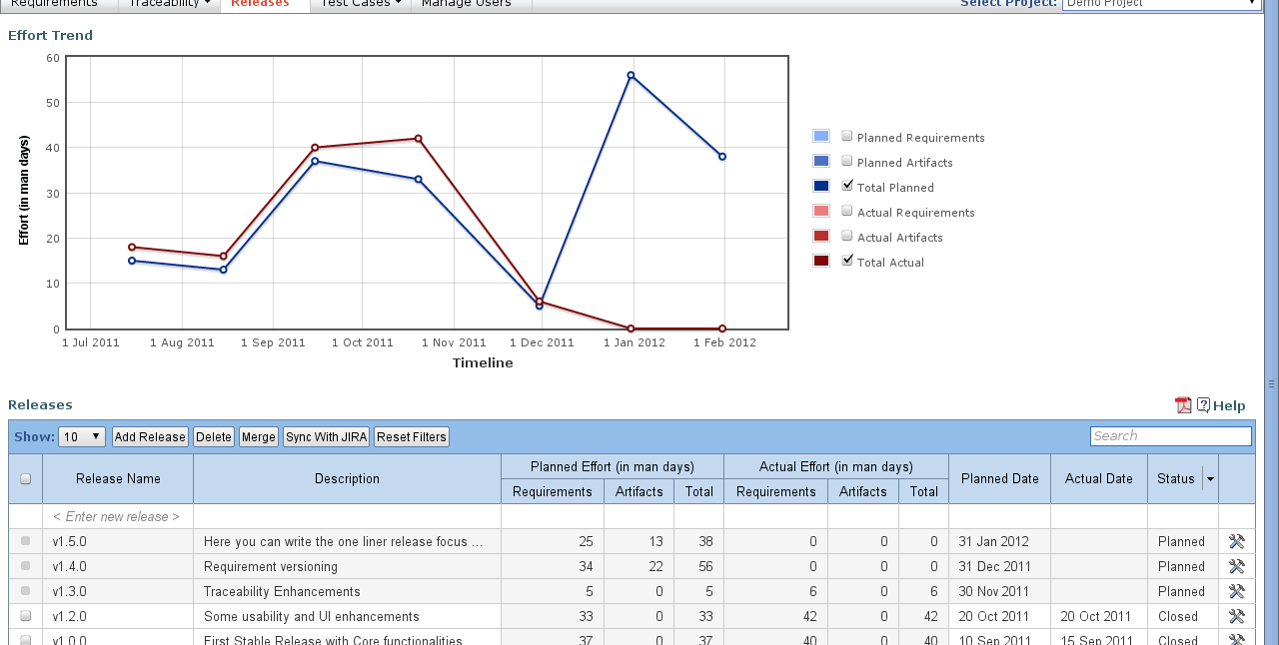
Release Management
Create new releases within RMsis or sync with JIRA versions
Planned and Actual effort is automatically updated from associated Requirements and Artifacts

Slide 19
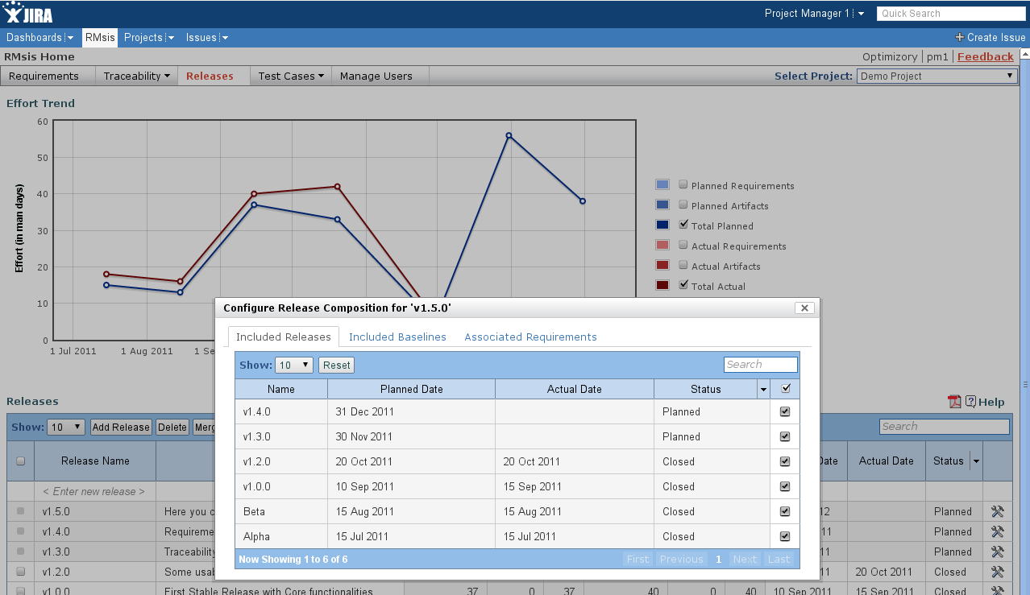
Define Release Composition
Identify the complete set of Requirements included in a Release
Useful for automatically mapping the Test Cases
Will form the basis of automatic generation of Release Notes

Slide 20
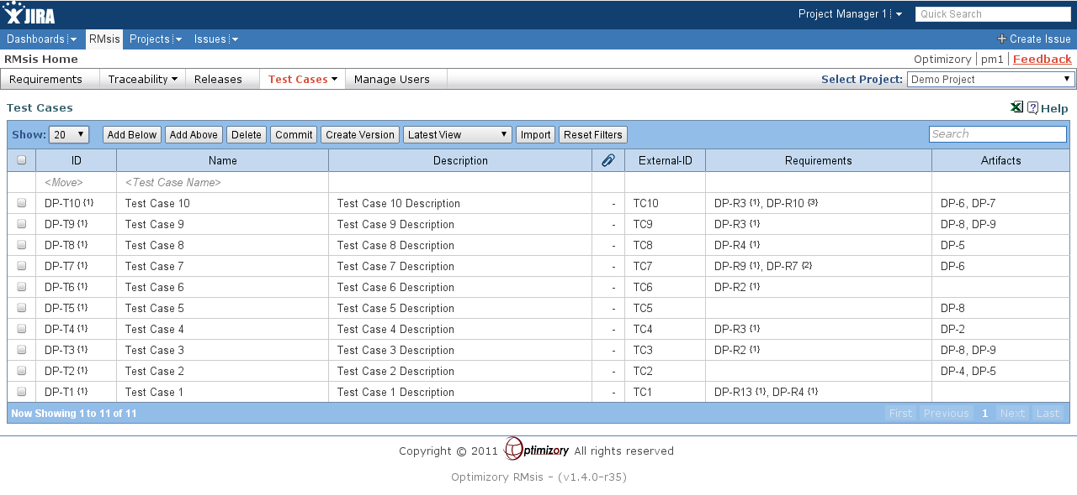
Specify Test Cases
Map Test Cases to Requirements
Map Artifacts (Issues) to Test cases

Slide 21
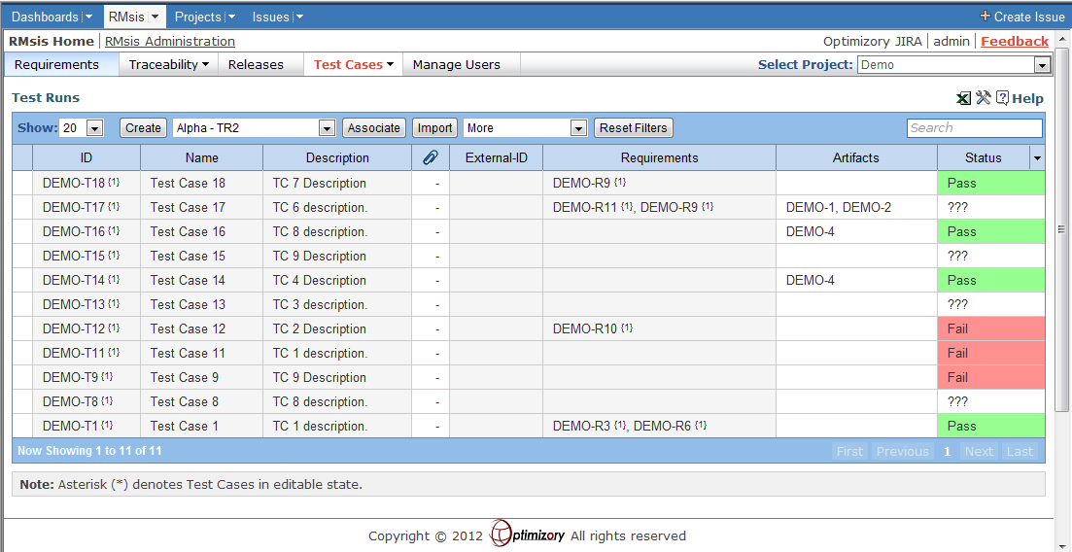
Create and Manage Test Runs
Create, Edit, Status Update, Copy, Commit a Test Run
Map Issues to Test Runs
Automatically generate Issues for failed Test Cases

Slide 22
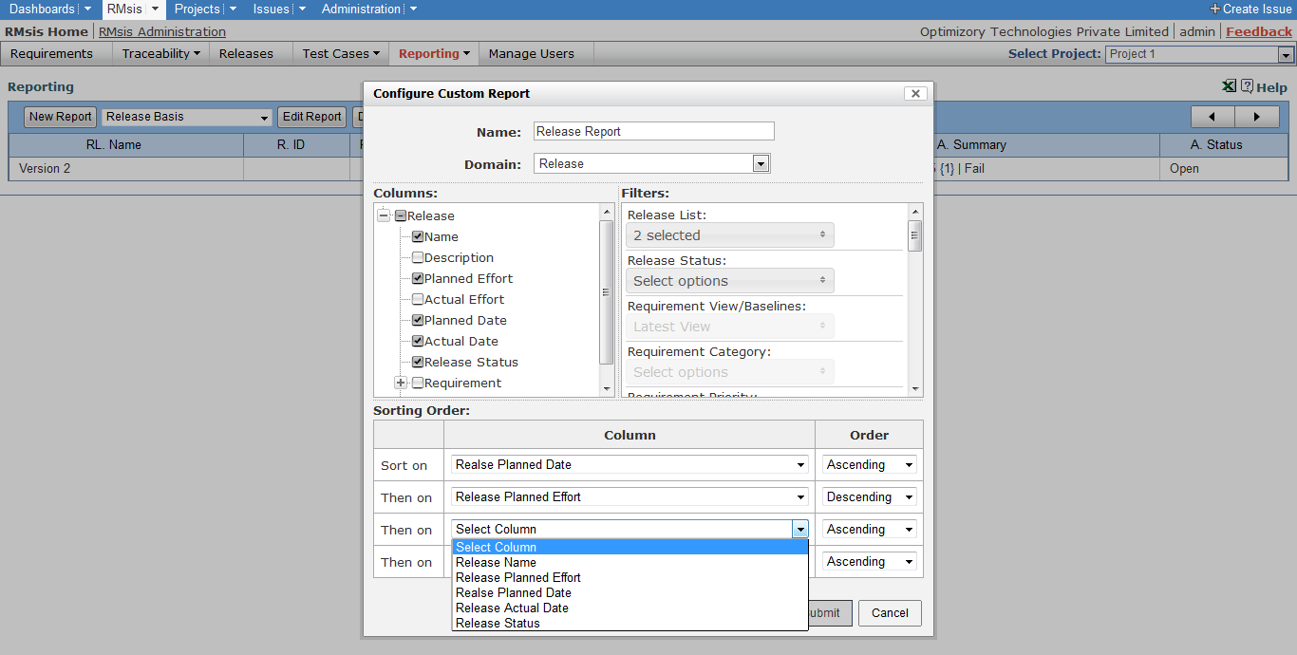
Custom Reports
Create and save custom reports.

Slide 23
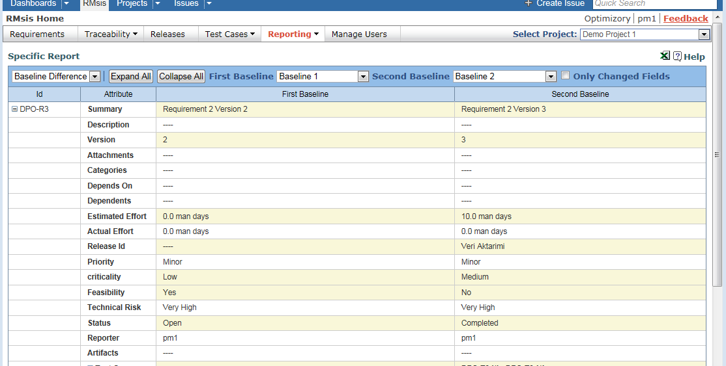
Specific Reports

Slide 24
Application Configuration

Slide 25
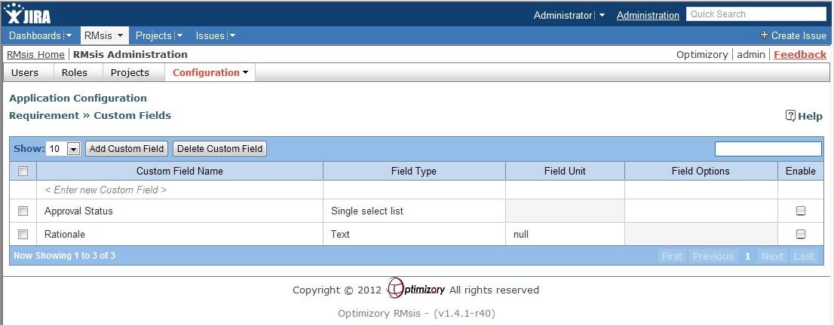
Define custom Attributes for Requirements

Slide 26
Administrative Functions

Slide 27
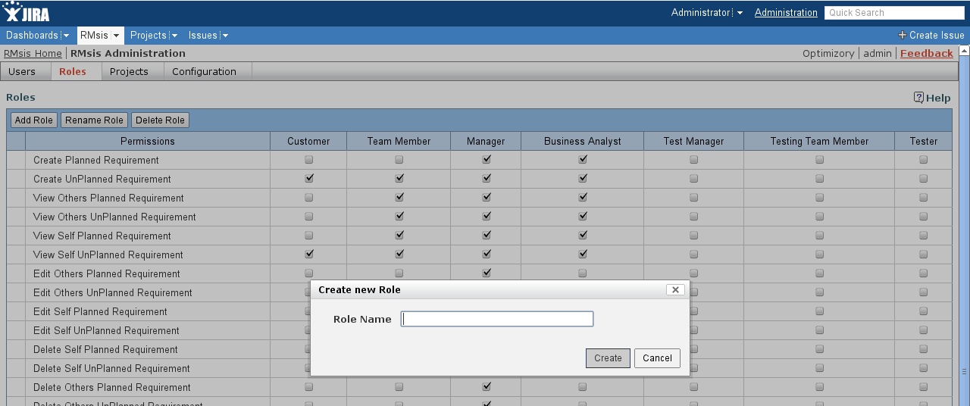
Admin can create Custom Roles

Slide 28
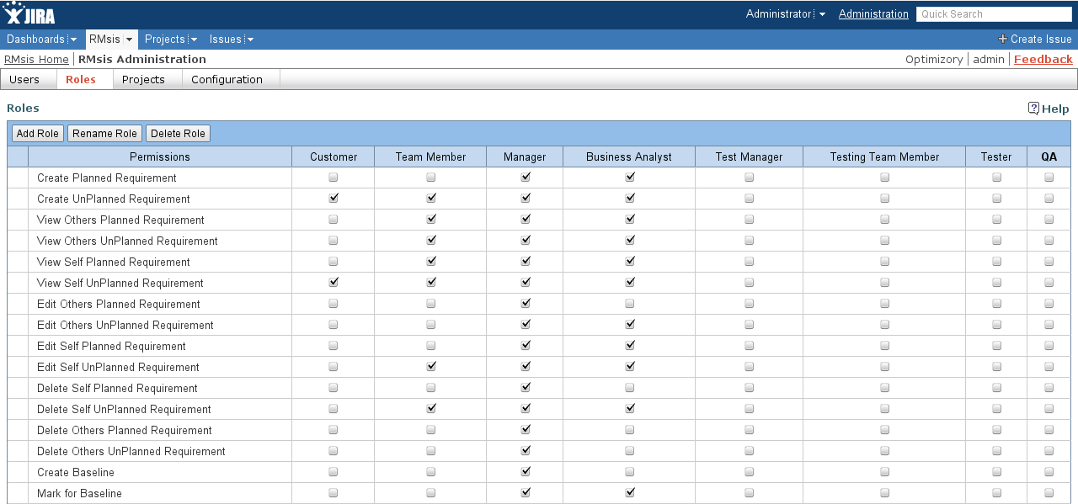
Role Management
Admin can assign permissions to any role.

Slide 29
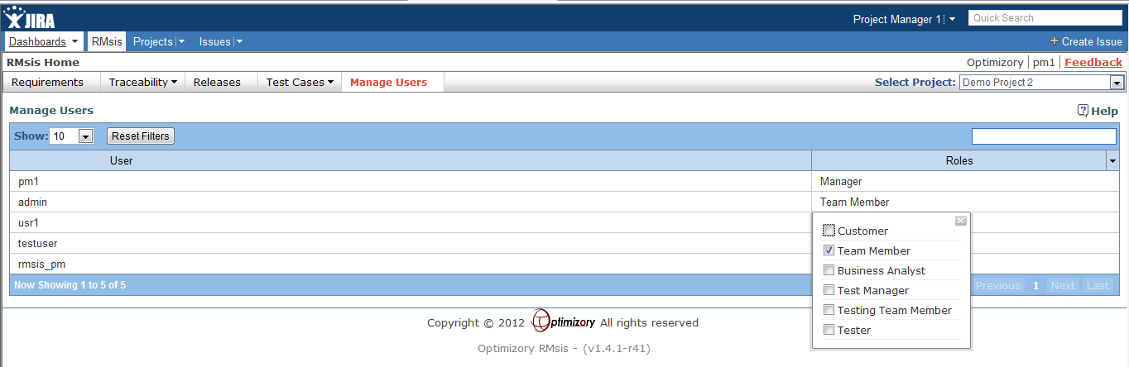
Role Management
Manager can assign roles to users

Slide 30
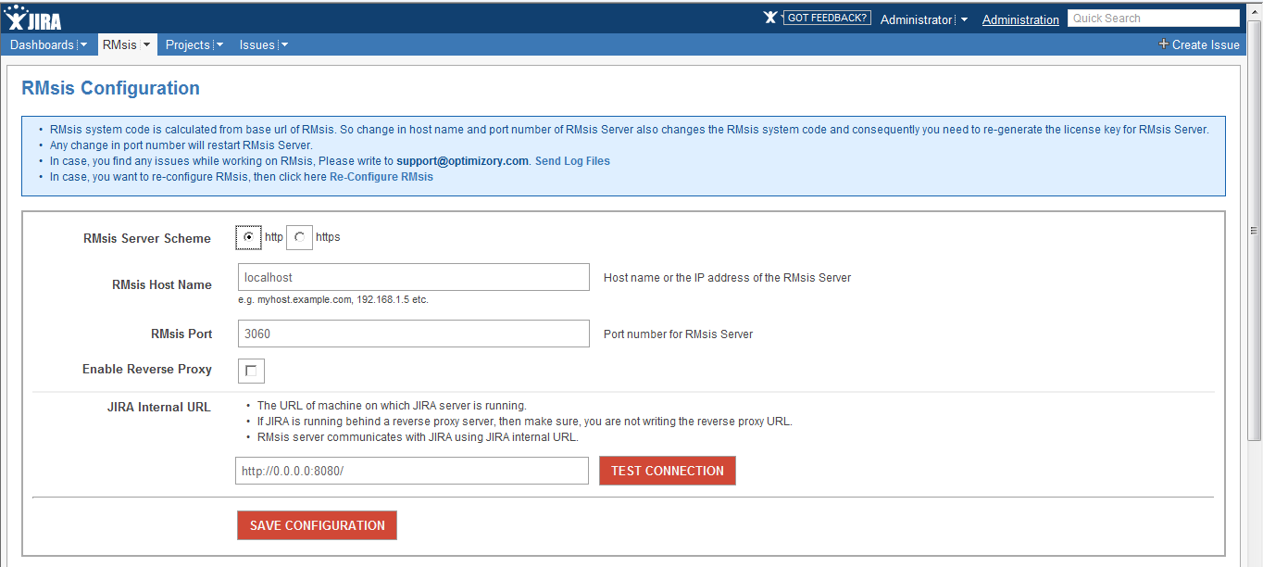
Configuration Management
Admin can reconfigure RMsis after installation.

Slide 31
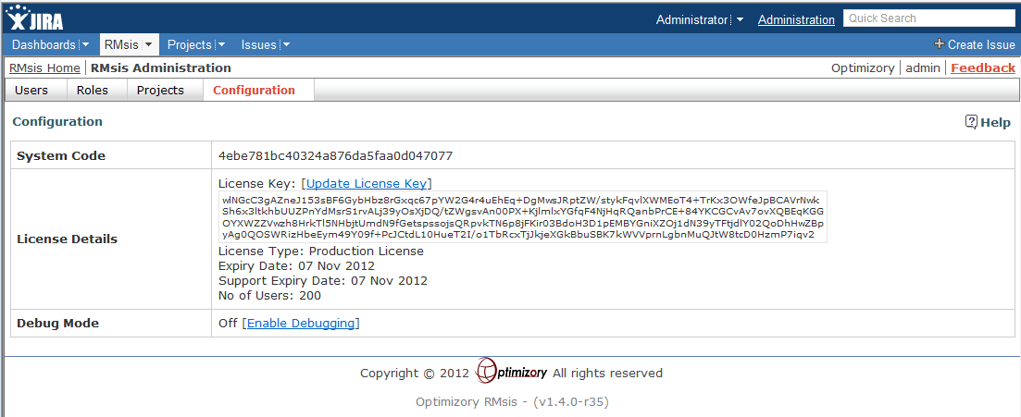
Configuration Management
Admin can update license and enable debug mode.

Slide 32
More Information

Slide 33
See Also ..
RMsis Home
  http://products.optimizory.com/rmsis
RMsis Documents
  Latest Release : http://docs.optimizory.com/display/rmsis/RMsis+Documentation+-+Latest+Release
  Preview of latest features : http://docs.optimizory.com/display/preview/Home
  Functions included in Releases : http://docs.optimizory.com/display/rmsis/Summary+of+RMsis+Releases
RMsis at Atlassian
  https://plugins.atlassian.com/plugin/details/30899
RMsis Demo link
  http://jira-rmsis.optimizory.com/
    Project manager login details
      Login: pm1
      Password: project123
    Team member login details
      Login: usr1
      Password: user123

Slide 34
Thanks!
For further questions or issues, contact support@optimizory.com
Notes:
Thanks for your time and interest !
Finally, we want to ensure that we build products, which really solve your problems.
So, if you have any open issues, please feel free to contact our support team.

